Slide 1
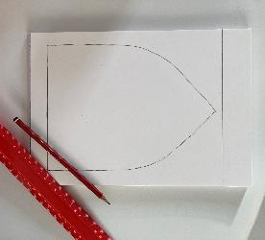
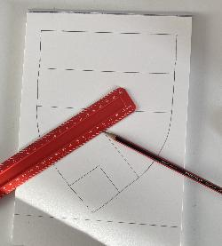
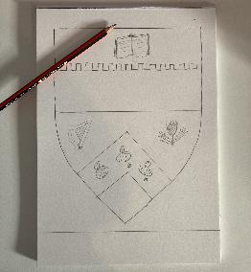
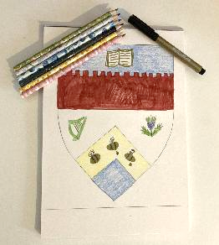
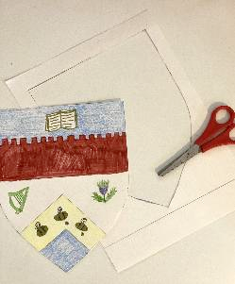
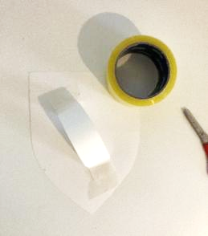
Design Your Own
Heraldic Shield
1. Draw a shield shape on a piece of card or use our shield template.
2. Use a ruler to impale or quarter your shield or add your ordinary(s)
3. Use a pencil to sketch charges which best describe you
4. Colour in your design and shield
5. Cut out your shield and handle
6. Attach your handle to the back of your shield using sticky tape
Notes:
All images © Crown Copyright HES

