Slide 1
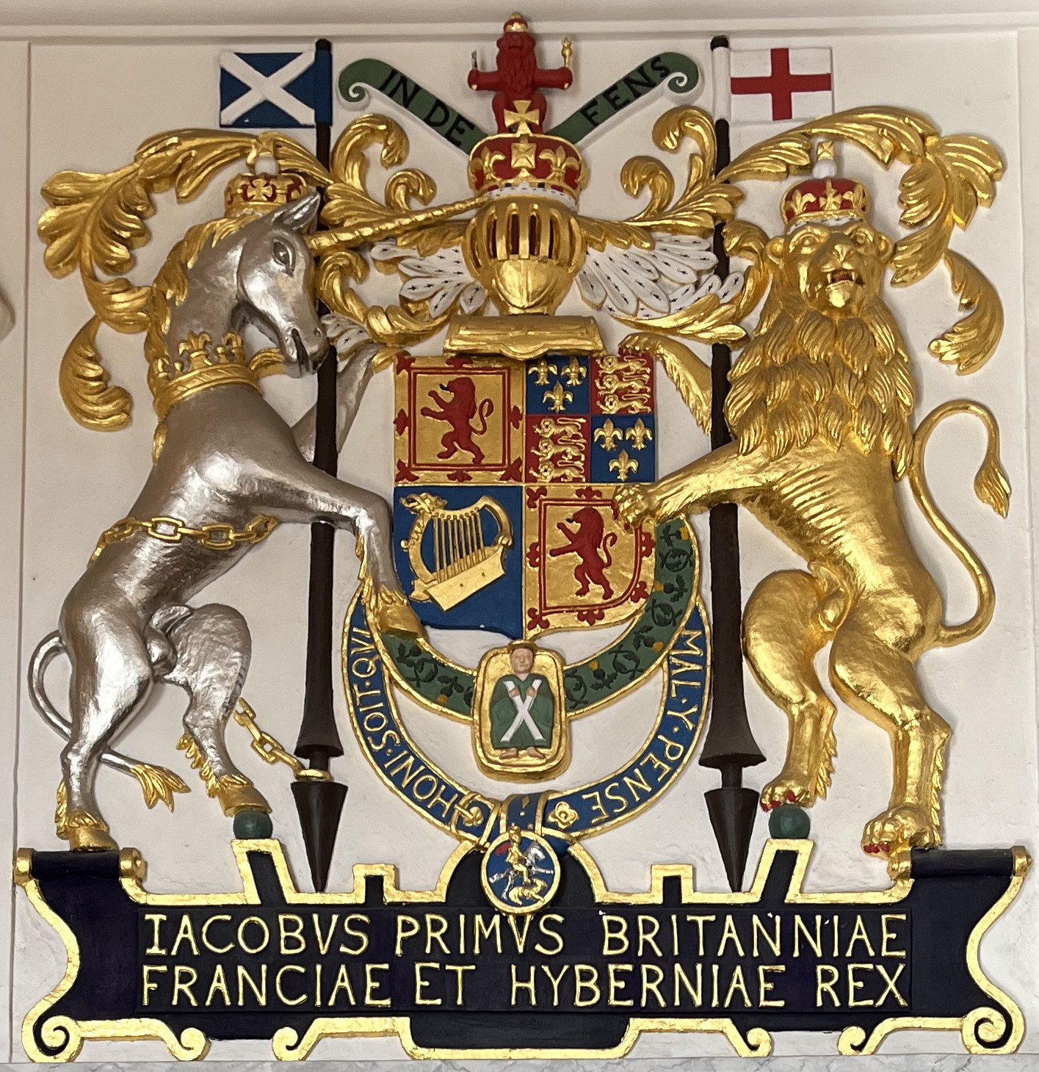
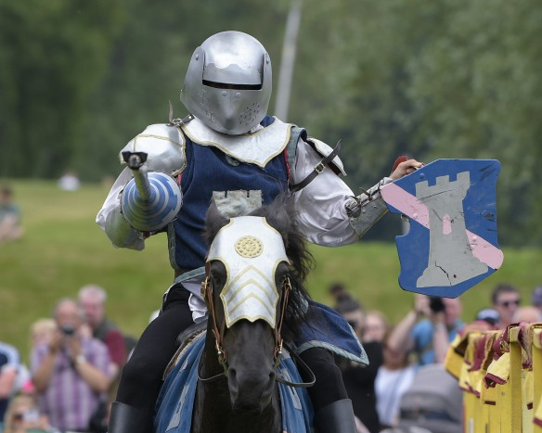
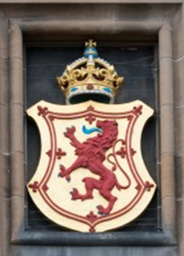
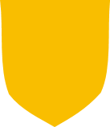
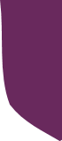

Make your own Heraldic Shield
What is a Coat of Arms?
A coat of arms is a unique design, like this image on the left, that belongs to a person, family or organisation. It can show off their achievements, their family line, their interests and their position in society.
Knights would wear their coat of arms on their tabard, hence the coat part of the name. It made them identifiable to others at the tournament or on the battlefield.
What is a Shield?
The shield is the central part of a coat of arms; it shares its shape with a knight's shield. If a person didn’t want to use the whole coat of arms, they would often just use the shield part of the design.
There are shields all over Edinburgh Castle – in stained glass windows, painted on walls and carved in stone. Each of these shields represents an important person in Edinburgh Castle’s history.
Blazon
Heralds kept records of everyone’s coat of arms. They used a special system called a Blazon to describe them. Many of these words come from old Norman French. This resource explains how to use Blazon so learners can design and describe their own shields.
Marshalling
Each person had their own unique shield but sometimes families would join their shields together. This was called Marshalling.
When two people got married, they could join their shields together. This was called impaling.
Their children could divide their shield into four parts and use each parent’s design on two of the sections. This was called quartering.
This is why you will often see shields divided into halves or quarters. Your learners could Marshall their shields and decorate some sections to represent a person close to them.
Notes:
Images from top (slide 1)
© Crown Copyright HES
© Alastair Ross
© Historic Environment Scotland

Slide 2
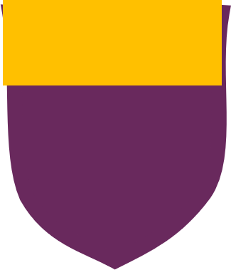
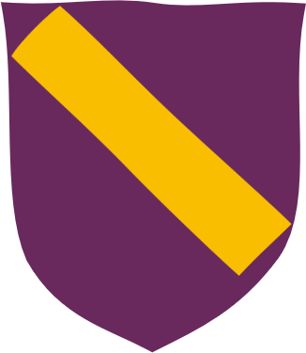
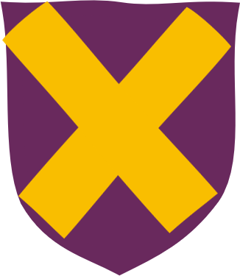
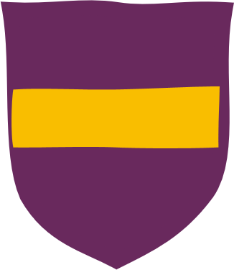
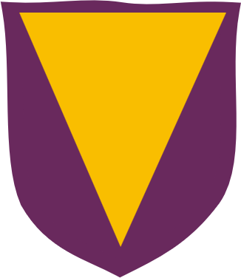

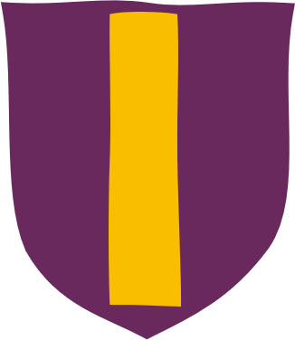
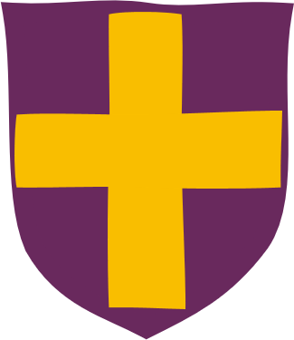
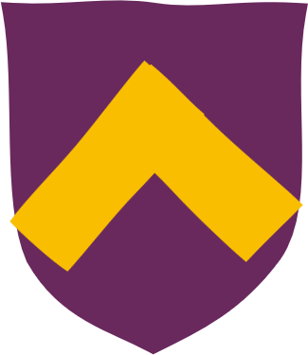
Ordinaries and colours
Ordinaries
Other shields have shapes on them called Ordinaries which have Blazon names. Shields can use one of them or mix and match lots of ordinaries. Some examples are set out below:
Chief
Bend
Saltire
Fess
Pile
Bordure
Pale
Cross
Chevron
Learners can choose any of these shapes for their shield. Ask them if they have a favourite.
Colours and Blazon Names
Traditionally only certain colours are used for shields. Their Blazon names are:
Red = Gules
Blue = Azure
Green = Vert
Purple = Purpure
Gold or Yellow = Or
Silver or White = Argent
Black = Sable
Some say the colours used on shields had hidden meanings. For example, blue was said to mean truthful. These meanings came from people connecting colours with qualities, feelings or things, like yellow = happy, red = hot, or green = nature. People would choose colours which they felt represented them, so a person who loved nature might choose green for their shield.
Ask your Learners: What meaning do you give colours?
Pick a colour
Think of any words which could be linked to that colour (could be adjectives, feelings, sensations or things)
Can the rest of the group guess which colour you have chosen?
Based on your group’s abilities and timings, you may want them to write their ideas down or do this activity in their heads or with a group / partner. This activity could be done in pairs, groups or as a whole class.

Slide 3
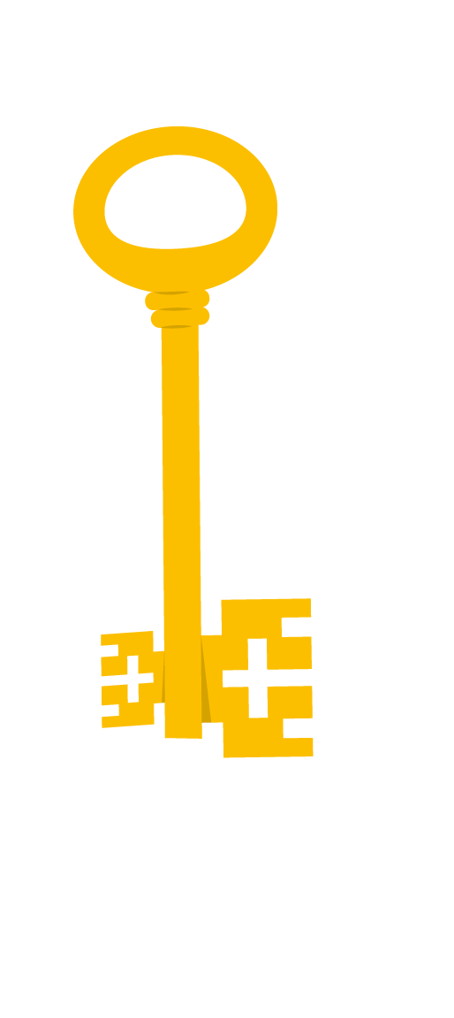


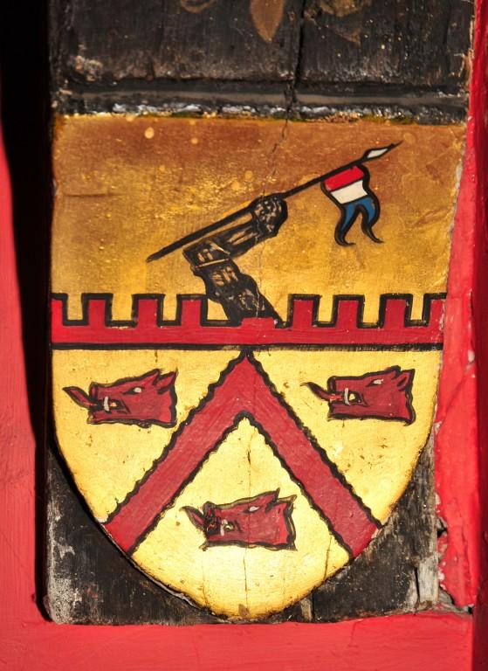

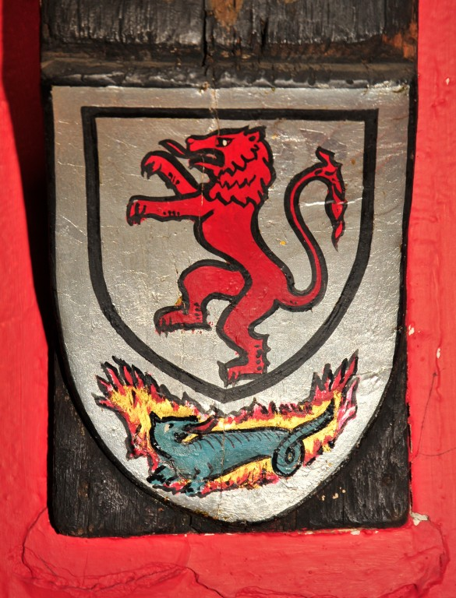
Charges and Decoding Shields
Charges
Charges are objects, shapes or animals which decorate a shield. You could use anything as a charge. Some examples might be:
Objects: a pencil, a book, a football, key, a candle, a castle
Animal and Nature: a dog, a bird, a flower, the moon or stars
Imaginary creatures: unicorns or dragons
You can have one big charge or lots of smaller ones. Like with colours each charge could have a special meaning to represent the shield's owner. e.g. rose = beauty, lightening = speed, dog = loyal.
Ask your Learners : Which charges represent you?
Think of some words which describe you e.g. strong, sporty, kind, love to read
For each describing word think of an object that could represent it e.g. love to read = book
Decoding Shields
Can you describe these shields from Edinburgh Castle like a herald? Remember to use the Blazon names we have learned.
Does it use any ordinaries?
What colours does it use?
What are the charges?
Ask your Learners: Using what you know about the secret meanings, can you make any guesses about what the person these shields belonged to was like?
Shield Descriptions: L- R
Ordinaries – Chevron
Colours – Or (Gold), Sable (Black) Gules (Red)
Charges - Battlements, Arm, Flag, Boar heads
Ordinaries - Bordure
Colours – Argent (Silver), Sable (Black) Gules (Red) and Vert (Green)
Charges - Lion and Dragon (on fire)
Use our shield template for learners to create their own heraldic shields.
Notes:
All images slide 3:
© Crown Copyright HES

