Slide 1
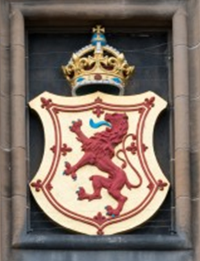
Heraldic Shields
Shields can be found all over Edinburgh Castle!
Discover the code used to describe shields
Create your own shield design
Notes:
Image: © Historic Environment Scotland

Slide 2
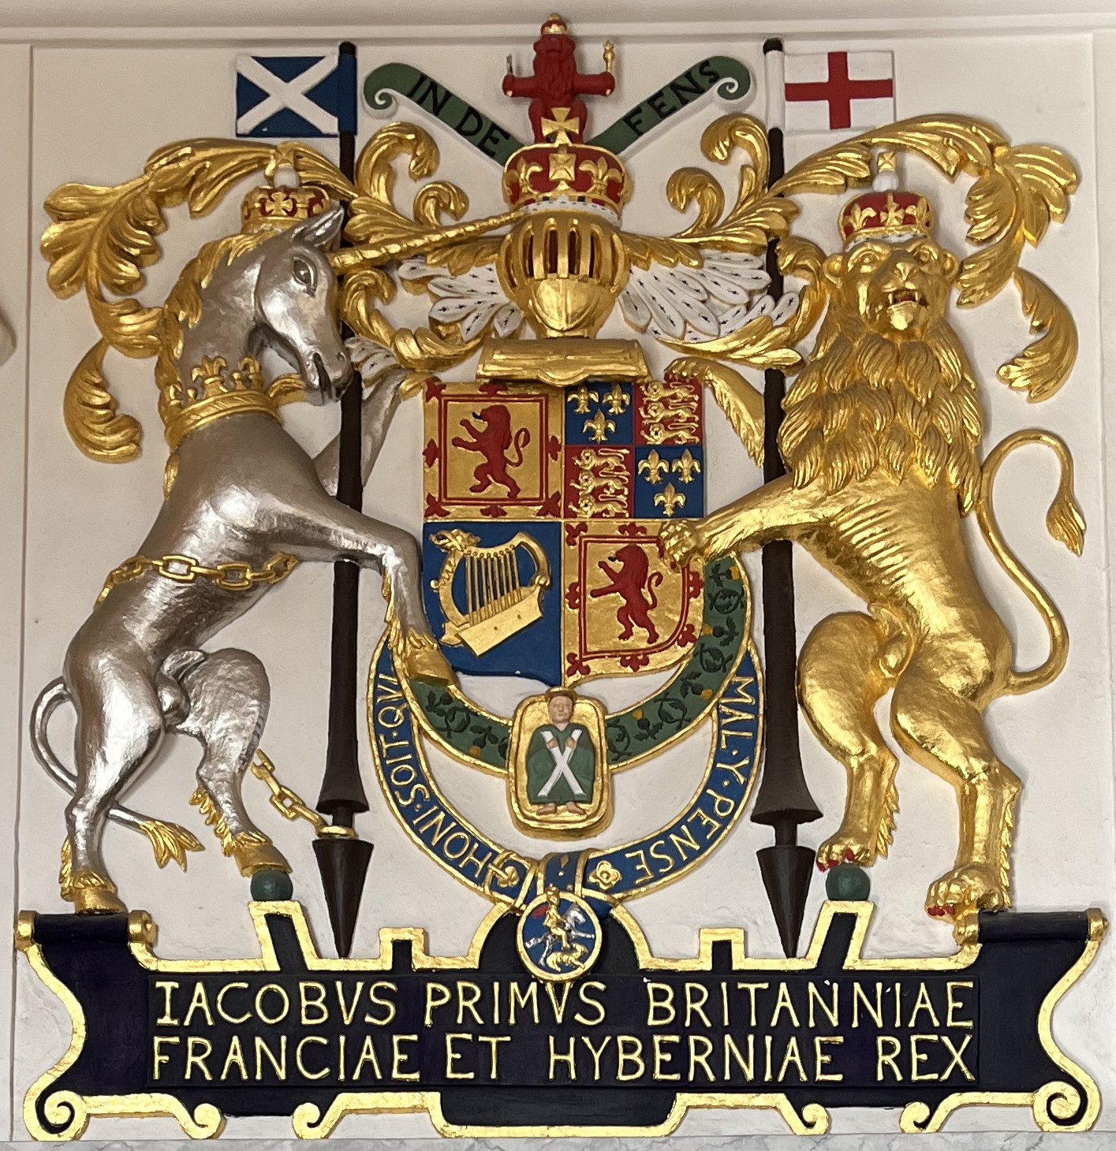
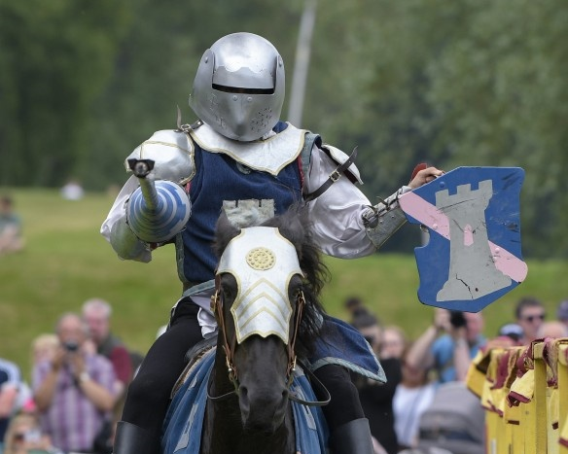
This is a Coat of Arms
A shield is part of a coat of arms. Each coat of arms is unique.
It can show off a person’s achievements, family line, interests and position in society.
It is named after the tabards and shields knights would wear.
Notes:
This is a coat of arms, you may have seen them before on documents, flags or buildings.
Each coat of arms belongs to a person, family or organisation and the design is unique to them. It can show off their achievements, their family line, their interests and their position in society.
It is called a coat of arms as in the past, Knights would wear then like an actual coat on their tabard and shield. As they were wearing armour and a helmet, the coat of arms would identify them to other knights and show whether they are a friend or an enemy.
Extra Information for Group Leaders
In Scotland Coats of Arms are granted by the Lord Lyon. They keep track of everyone’s Coat of Arms and have a public register listing them all. You can find out more about the Lord Lyon here: https://www.courtofthelordlyon.scot/blazoning.htm
Images (L-R)
© Crown Copyright HES
© Alastair Ross

Slide 3
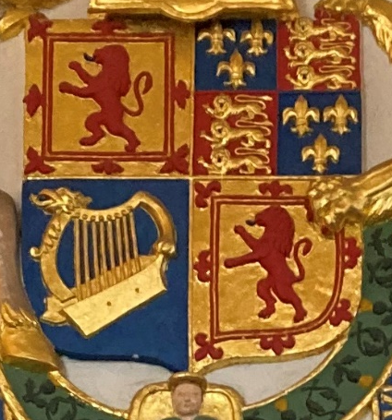
Which part is the shield?
Motto
Crest
This section is the Shield
Helmet
Supporters
Notes:
Which part of a coat of arms is a shield?
Each part of a coat of arms has a special name: the supporters, the crest, the helmet, the motto, and the shield.
If a person didn’t want to use the whole complicated coat of arms, they would often just use the shield part of the design.
Task
Which part of this coat of arms do you think is the shield?
The shield is the central section which is shield shaped and split into four quarters. You can click the mouse to label all parts of the coast of arms.
Image:
© Crown Copyright HES

Slide 4
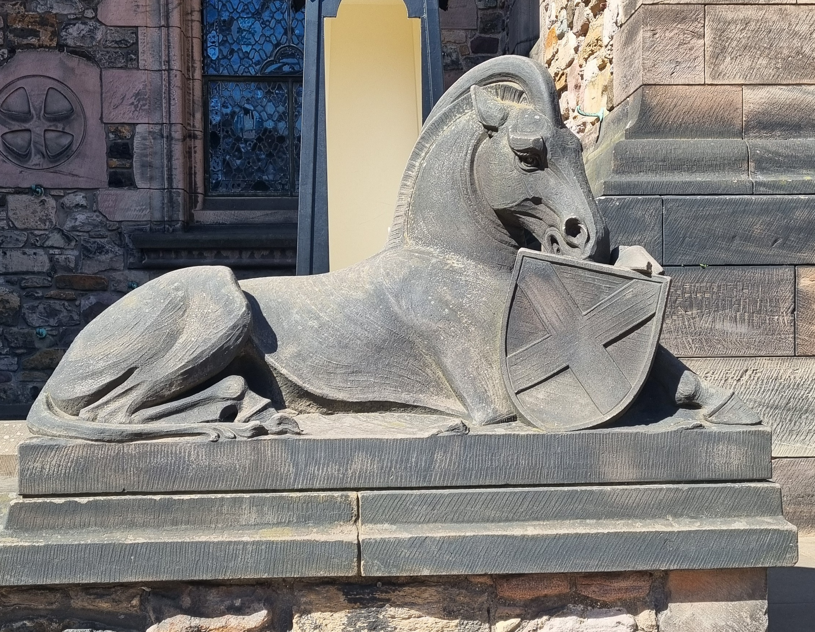
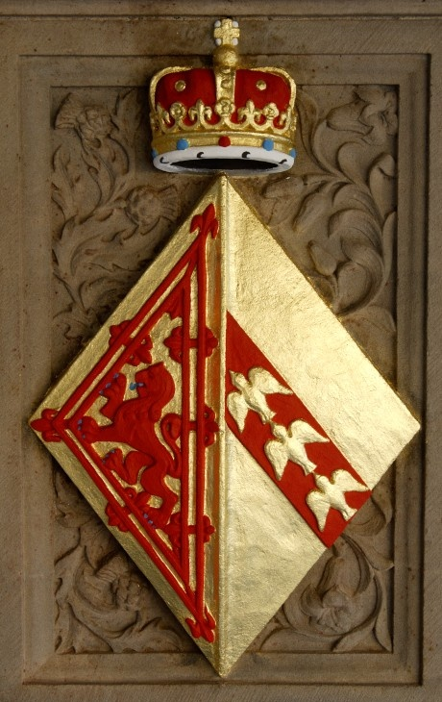
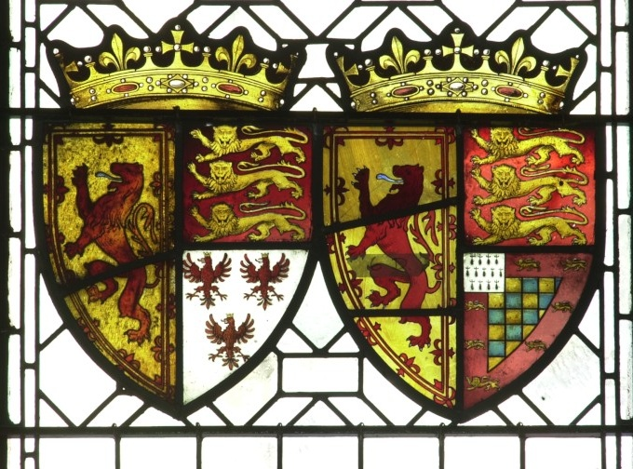
Spotting shields in Edinburgh Castle
Shields can be found all over Edinburgh Castle!
Stained glass windows in the Great Hall
Painted on walls in the Royal Apartments
Carved in stone on the National War Memorial
Notes:
Spotting Shields
You will see shield all over Edinburgh Castle – in stained glass windows, painted on walls and carved in stone. Each of these shield represent at important person who was part of Edinburgh Castle’s history.
Extra Information for Group Leaders
These shields can be found all around Edinburgh Castle:
Top Left– On the gatehouse in front of the castle
Bottom Left - In the stained-glass windows in the Great Hall
Bottom centre – outside the entrance to the war memorial
Bottom Right – On the outside wall of the Great Hall visible from Crown Square, this is shield of Mary of Guise, wife of James V and mother of Mary Queen of Scots. Women, unless they were Queen, could not have their design in a shield shape as they did not fight in battles, instead they used a diamond shape.
Images (L-R)
© Historic Environment Scotland
© Crown Copyright HES
© Historic Environment Scotland
© Crown Copyright HES

Slide 5
How to read a shield
Heralds were people in charge of keeping a record of everyone’s coats of arms, including their shields.
The Herald’s special way of describing a shield is called a Blazon.
Many of the words used in a Blazon come from an old language called Norman French.
Let’s explore the special terms used in a Blazon
Notes:
How to read a shield
Heralds were people in charge of keeping a record of everyone’s coats of arms, including their shields.
The Herald’s special way of describing a shield is called a Blazon.
Many of the words used in a Blazon come from an old language called Norman French.
Image:
© Historic Environment Scotland

Slide 6

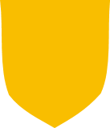
Marshalling
Each person had their own unique shield (though some people with the same surname would have similar shields).
Sometimes families would join their shields together. This was called Marshalling.
Purple and Blue marry and
Become the Purple-Blues.
Their shields are impaled (joined together).
+
=
Purple
Blue
If the Purple-Blues have a child, the child’s shield could be quartered.
This explains why you will often see shields divided into halves or quarters
Notes:
Marshalling
Each person had their own unique shield (though some people with the same surname would have similar shields).
Sometimes families would join their shields together, this was called Marshalling.
When two people met and decided to get married, they could each cut their shields in half and join them together, this was called impaling.
If they then had children, their children could divide their shield into four parts and use each parent's design on two of the sections, this was called quartering.
This is why you will often see Shields divided into halves or quarters.

Slide 7
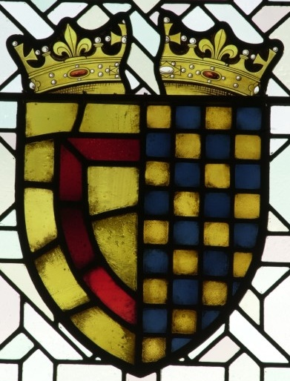
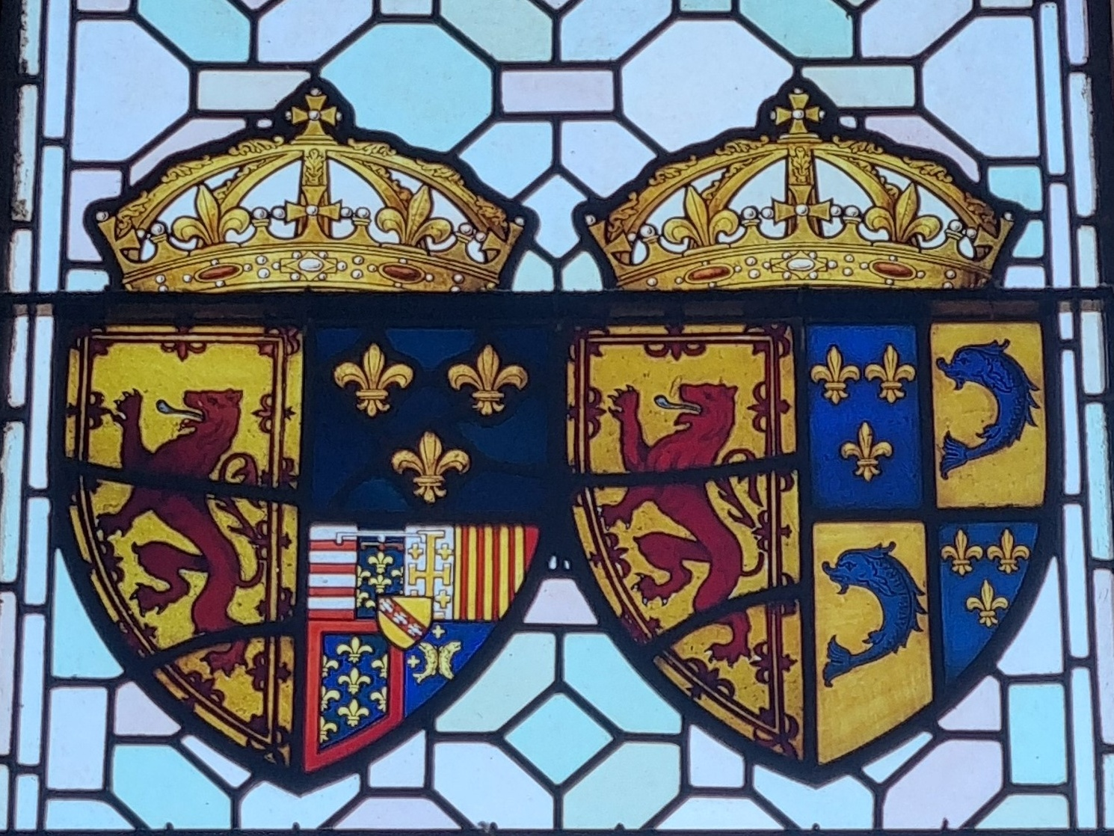
Marshalling your own shield
You could choose to Marshall your shield and decorate some sections to represent your family or people close to you.
Impaled
Quartered
Notes:
Marshalling your own Shield
You could choose to Marshall your shield and decorate some sections to represent your family or people close to you.
Task:
Encourage your group to think about whether they want to divide their shield into sections and who are the people close to them they might want to include.
Images:
© Crown Copyright HES

Slide 8
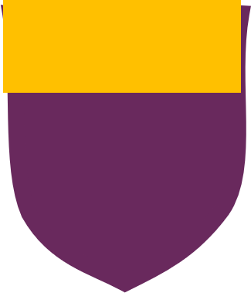
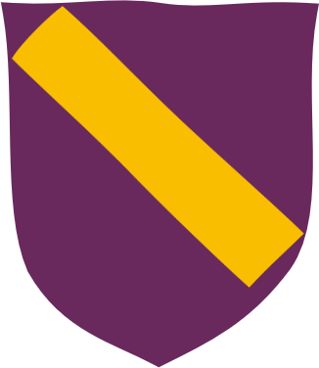
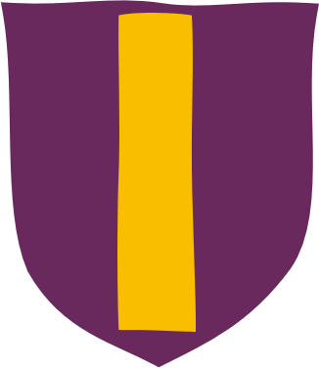
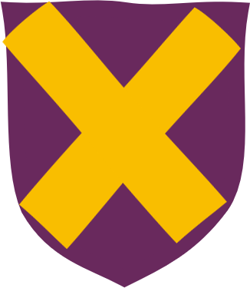
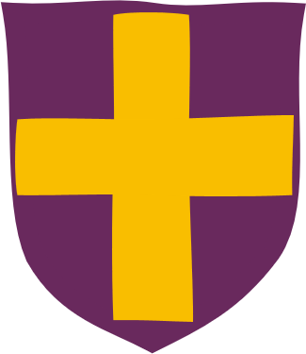
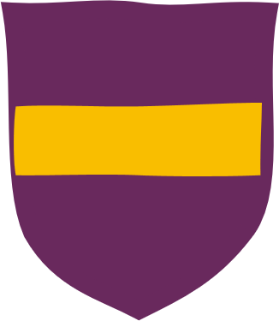



Ordinaries
Other shields have shapes on them called Ordinaries which have special Blazon names. You can see some examples below:
Chief
Bend
Pale
Saltire
Cross
Fess
Bordure
Chevron
Pile
You could choose any of these shapes for your shield. Which is your favourite?
Notes:
Ordinaries
Other shields have shapes on them called Ordinaries which have Blazon names. You can use just one of them or you could mix and match.
Task:
Encourage discussion within your group
Which Ordinaries do they like? Why? Encourage them to use the proper Heraldic names
Do they think they might choose one of these for their shield?

Slide 9


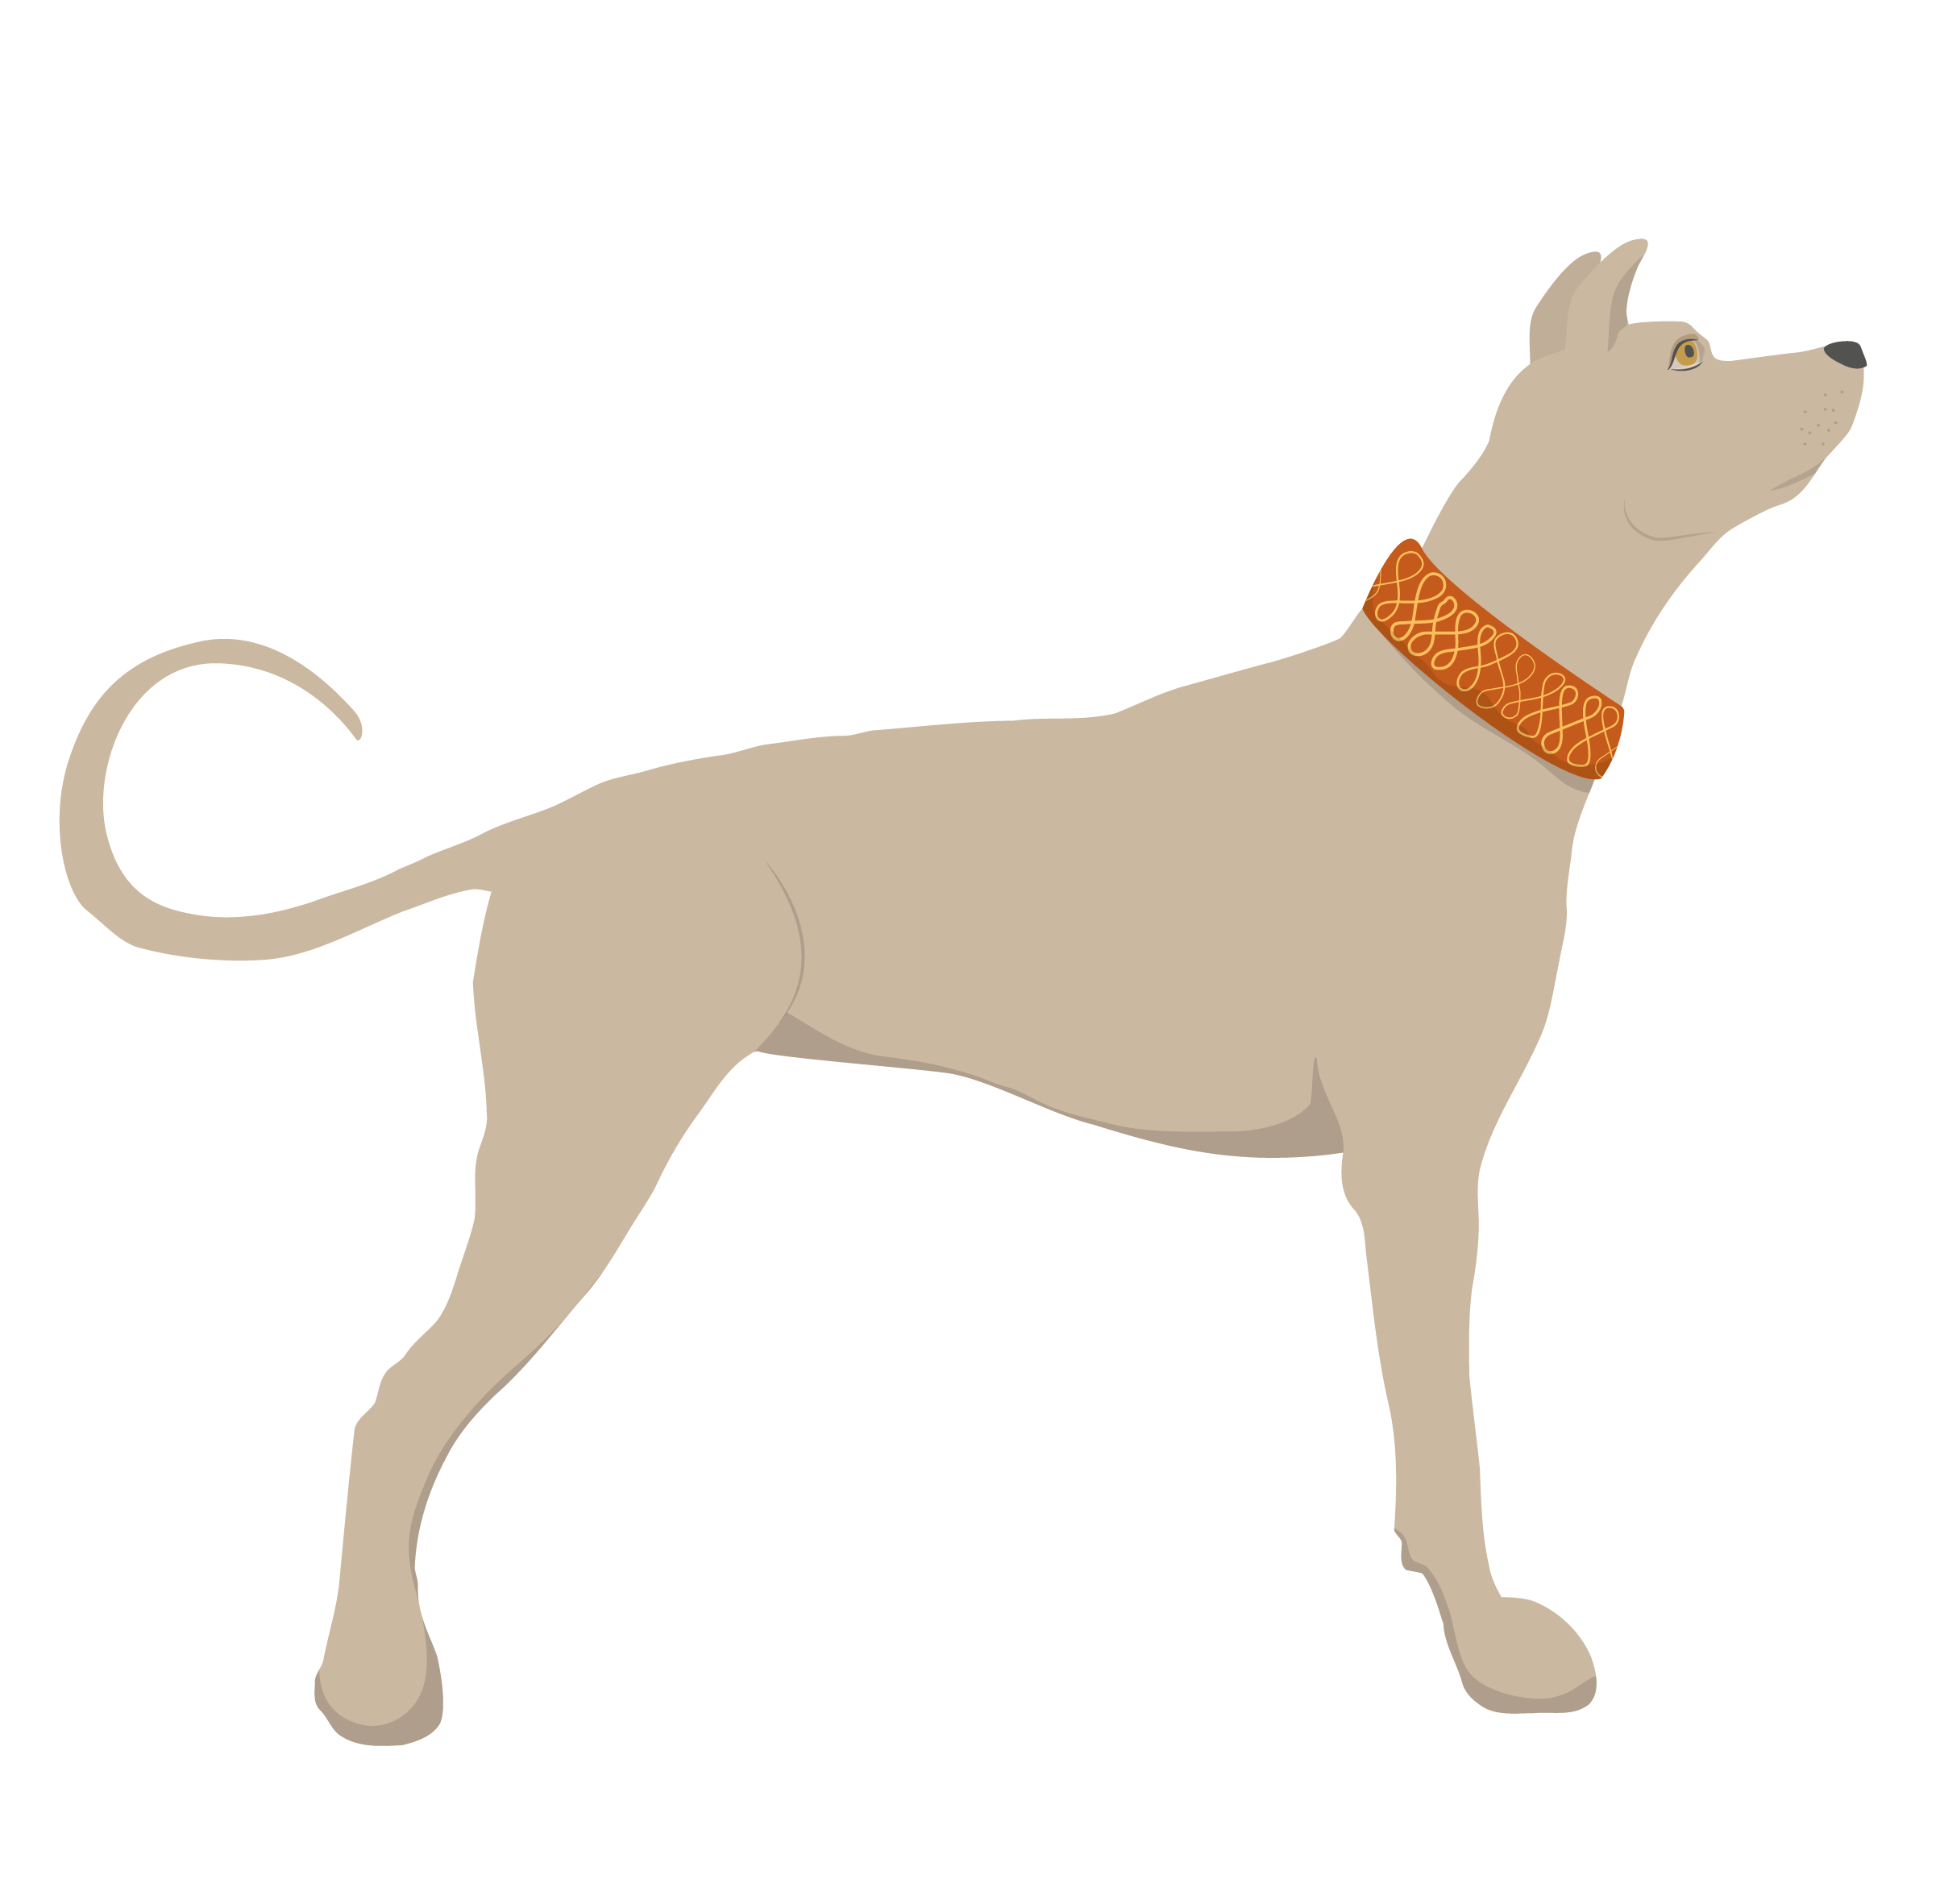











Charges
Charges are objects, shapes or animals which decorate a shield.
Here are some examples:
You could have one big charge or lots of smaller ones.
Each charge could have a special meaning to represent the shield’s owner.
Which charges are on the shields? What do you think each might tell us about the owner?
Notes:
Charges
Charges are objects, shapes or animals which decorate a shield. You could use anything as a charge.
Everyday objects: a pencil, a book, a football, key, a candle
Animal and Nature: a dog, a bird, a flower, the moon or stars
Imaginary Creatures: unicorns or dragons
You can have one big charge or lots of smaller ones.
Each charge could have a special meaning to represent the shields owner
Task:
Look at the charges on the shields. Discuss- what do you see?
Why might someone have chosen to have these on their shield? What might it tell us about them?
Possible answers: rose = beauty, lightening bolt = speed, dog = loyalty

Slide 10

Charging your shield
Which words best describe you?
Think of some words which describe you (e.g. strong, sporty, kind, funny, love to read)
For each describing word, choose an object to represent it e.g. love for reading = a book
Which will you choose to ‘charge’ your shield with?
Notes:
Task:
What words best describe you?
Ask each learner to think of some words which describe them e.g. strong, sporty, kind, love to read. They can do this on paper, in their heads or discuss with a partner
Then for each describing words they have thought of, ask them to think of an object to represent it e.g. love to read = a book
Now they can decide which charge they will put on their shield!

Slide 11
Colours and meanings
Colours were used to tell us something about who the shield belonged to.
What meanings do you give to colours?
Pick a colour
Think of any words you might link to that colour (adjectives, feelings, sensations or things)
Red
Blue
Black
Green
Silver, White
Yellow, Gold
Purple
Notes:
Colours
Colours were used to tell us something about who shield belonged to.
Task: What meanings do you give colours?
Pick a colour
Think of any words you think are linked to that colour (could be adjectives, feelings, sensations or things)
Can the rest of the group guess which colour you have chosen?
Based on your group’s abilities and timings you may want them write them down or just do this activity in their heads. This activity could be done in pairs, groups or as a whole class.

Slide 12
Colours and Blazon names
Traditionally only certain colours are used for shields. Their Blazon names are:
Red = Gules
Blue = Azure
Green = Vert
Purple = Purpure
Black = Sable
Gold or Yellow = Or
Silver or White = Argent
Which colours will you choose to represent you on your shield?
Notes:
Colours
Traditionally only certain colours are used for shields; their Blazon names are:
Red = Gules
Blue = Azure
Green = Vert
Purple = Purpure
Black = Sable
Gold = Or
Silver = Argent
Some say the colours used on shields had hidden meanings, for example blue was said to mean truthful.
These meanings came from people connecting colours with qualities, feelings or things for example yellow = happy, red = hot, or green = nature.
People would choose colours which they felt represented them, so a person who wanted to be seen as truthful might have a blue shield or a person who loved nature might choose a green one.
Task:
Discuss with your group what colours they might choose for their shield and why.

Slide 13
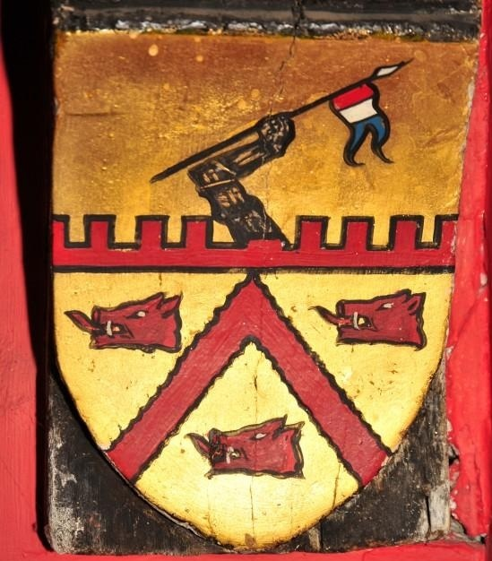

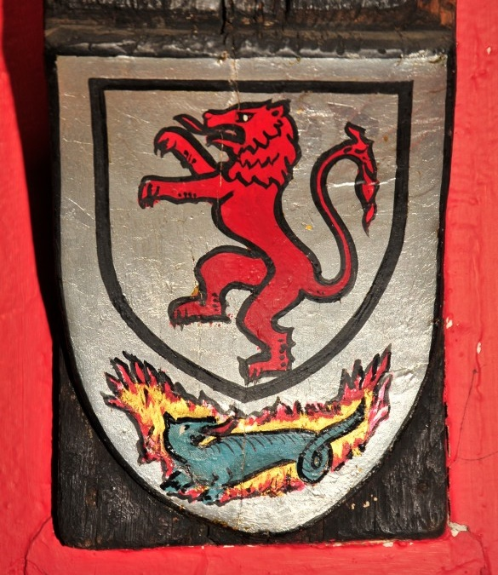
Decoding Shields
Can you describe these shields from Edinburgh Castle like a herald?
Remember to use the Blazon names we have learned.
Does it use any ordinaries? (slide 8)
What are the charges? (slides 9 - 10)
What colours does it use? Can you remember the Blazon names? (slides 11-12)
Using what you know about secret meanings, can you make any guesses about what the person this shield belonged to was like?
Notes:
Decoding Shields
Can you describe these shields from Edinburgh Castle like a herald?
Remember to use the Blazon names we have learned.
Task 1:
Using what you have learned about shields can you describe these shields from Edinburgh Castle?
Does it use any ordinaries?
What colours does it use? (Can you remember the Blazon names?)
What are the charges?
Shield 1
Ordinaries – Chevron
Colours – Or (Gold), Sable (Black) Gules (Red) and Azure (Blue)
Charges - Battlements, Arm, Flag, three Boar heads
Shield 2
Ordinaries - Bordure
Colours – Argent (Silver), Sable (Black) Gules (Red) and Vert (Green)
Charges - A Lion and a Dragon on fire
Task 2:
Using what you know about the secret meanings, can you make any guesses about what the person this shield belonged to was like?
We have included some suggested meanings but there is no correct answers, you learners’ response are valid if they have a reason behind it.
Shield 1
The arm and the castle might suggest strength
The boar might mean they are ferocious
Shield 2
The lion in red could suggest bravery.
The red lion rampant was used on the Scottish royal family's coat of arms, perhaps they were linked to the royal family or wanted to be.
The dragon on fire might mean powerful or dangerous
Images:
© Crown Copyright HES

Slide 14
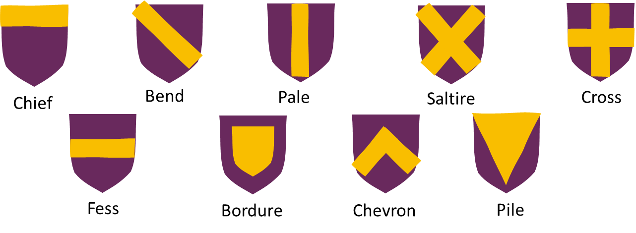

Design your own shield
Using your shield template, design your own shield!
1. Design your shape: Use a ruler to impale or quarter your shield or add your ordinary(s).
2. Add your charges: Use a pencil to sketch charges which best describe you.
3. Choose your colours: Use the colouring pens and pencils to colour in your design and shield.
Red = Gules
Blue = Azure
Green = Vert
4. Cut out your shield and handle.
5. Attach your handle to the back of your shield using sticky tape.

