Slide 1
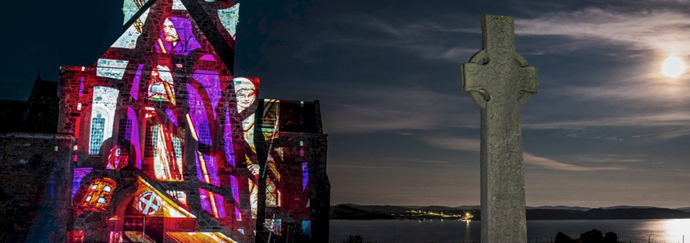
DISCOVER HERITAGE CAREERS

Slide 2
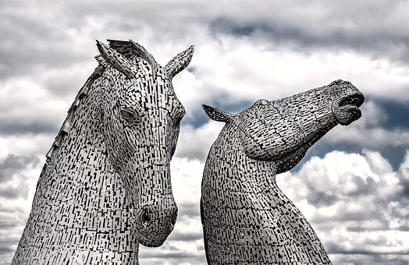
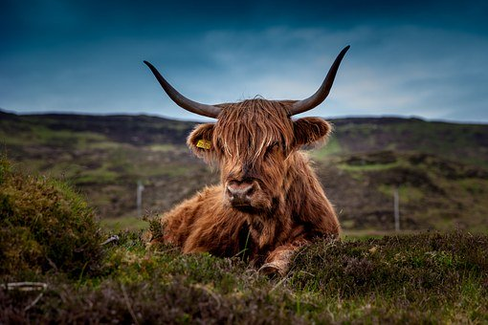
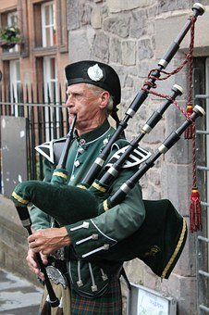
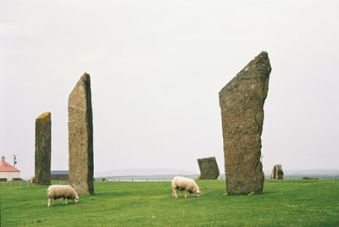
Discussion: What do you think Heritage is?

Slide 3
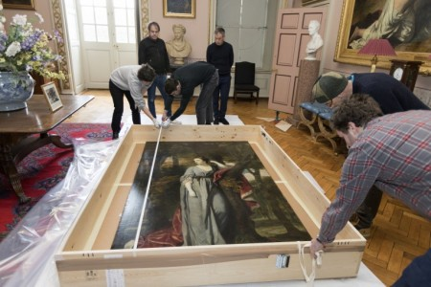
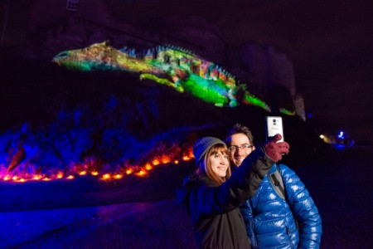
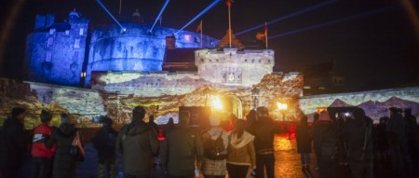
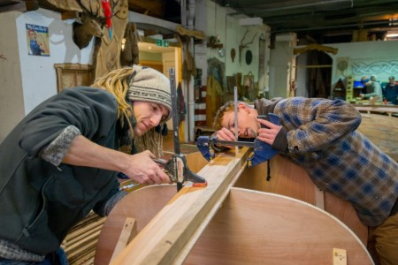
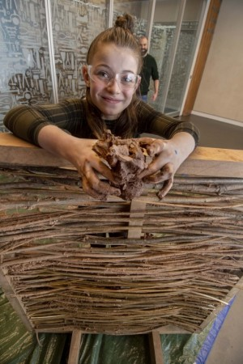
How about….?

Slide 4
Heritage is….
Design
People
Technology
Places
Discovery
Heritage is …Scotland

Slide 5
HERITAGE QUIZ
Notes:
Culture and Heritage Quiz
6 multi choice questions, answers are animated

Slide 6
Q1
The Scottish football museum
Hampden Park
Stirling Smith
Museum
Where can we find the world’s oldest football?

Slide 7
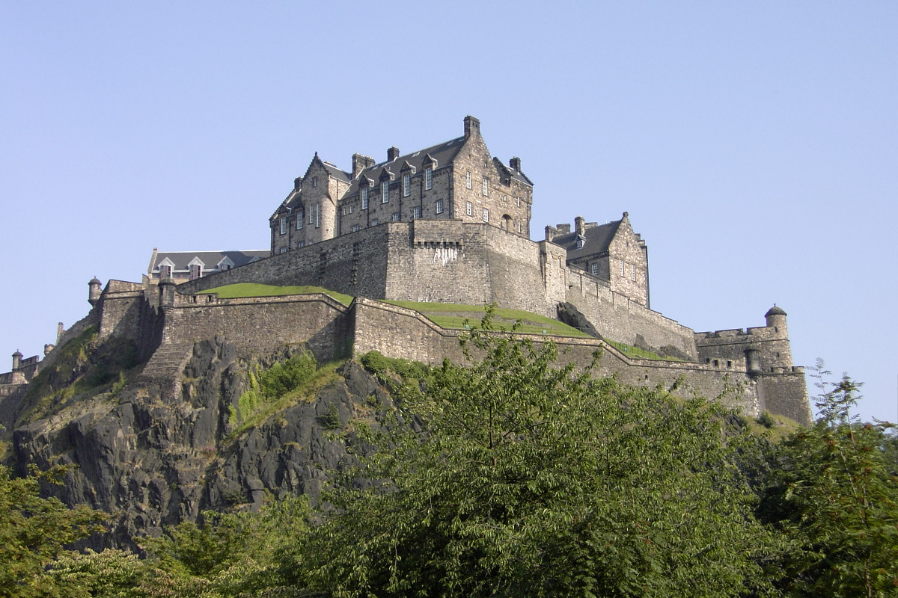
Q2
TENS
HUNDREDS
THOUSANDS
Approximately, how many castles are in Scotland?
This Photo by Unknown Author is licensed under CC BY-SA

Slide 8
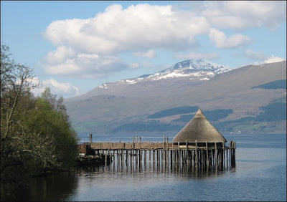
Q3
8000 BC
12,000 BC
700 BC
How old is the earliest archaeological evidence of people living in Scotland?
This Photo by Unknown Author is licensed under CC BY-SA-NC

Slide 9
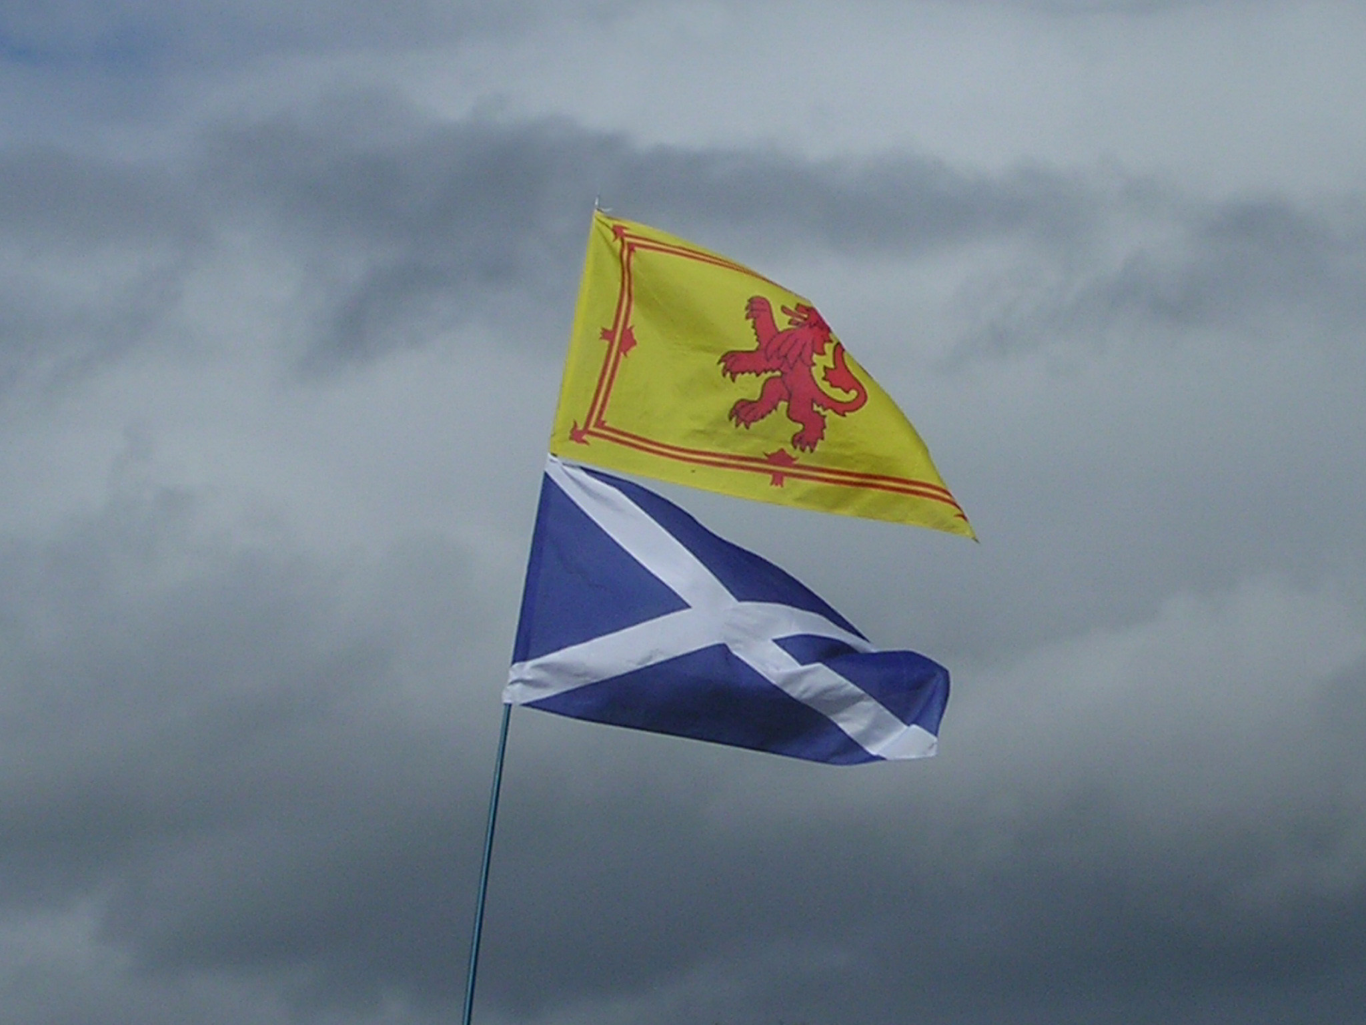
Q4
LION
DRAGON
UNICORN
What is Scotland’s national animal?
This Photo by Unknown Author is licensed under CC BY-SA

Slide 10
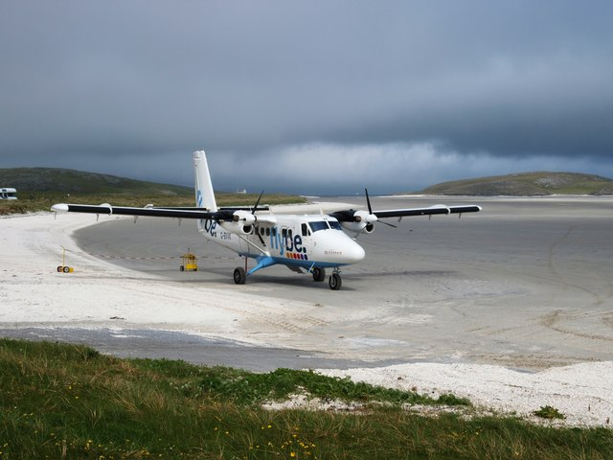
Q5
HISTORY & CULTURE
SPORTING ATTRACTIONS
FRIENDLY PEOPLE
Which of the following is one of the main reasons given by tourists for visiting Scotland?
This Photo by Unknown Author is licensed under CC BY-SA

Slide 11
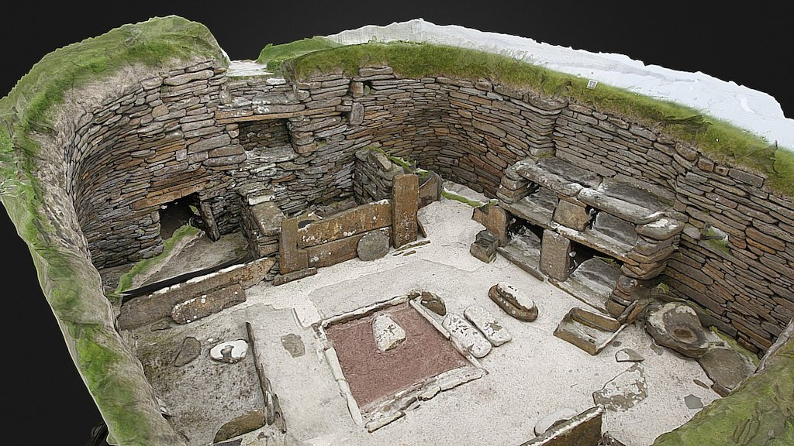
Q6
More than 200
More than 100
More than 50
How many 3D models of buildings and objects are online?
This Photo by Unknown Author is licensed under CC BY-NC
https://skfb.ly/6SKBV

Slide 12
HERITAGE JOBS

Slide 13
DISCOVER HERITAGE: CAREERS VIDEO
Notes:
Culture and Heritage Quiz
6 multi choice questions, answers are animated

Slide 14
Please stand up if you?
Are Creative?
Love new technology?
Like Research and problem solving?
Want a varied work environment?
Love Teamwork?
Like to fix things?
Want to protect environment?
Would like a fun and exciting job?
Want to promote Scotland
Notes:
Stand up game ;
Explain that young people should stand up when they agree with a statement presented on screen.
Reveal one at a time.
The aim of this game is to highlight some skills and qualities that could lead you into this sector. This is to make group feel inclusive and that even now they have something to offer as the outcome should be everyone in group standing.
Statements are- Stand Up if you;
Are Creative?
Love New Technology?
Like Research and Problem Solving?
Want a varied work environment
Like to work with the community?
Love Team Work?
Like to fix things?
Want to protect the environment?
Would like a fun and exciting job?
Want to promote Scotland

Slide 15
WELL DONE EVERYONE! You already have useful skills that the heritage sector needs SO LET’S FIND OUT MORE …
This Photo by Unknown Author is licensed under CC BY-NC-ND
Notes:
Congratulate everyone and highlight the purpose was to show them they already have some of the skills and qualities needed for this sector.

Slide 16
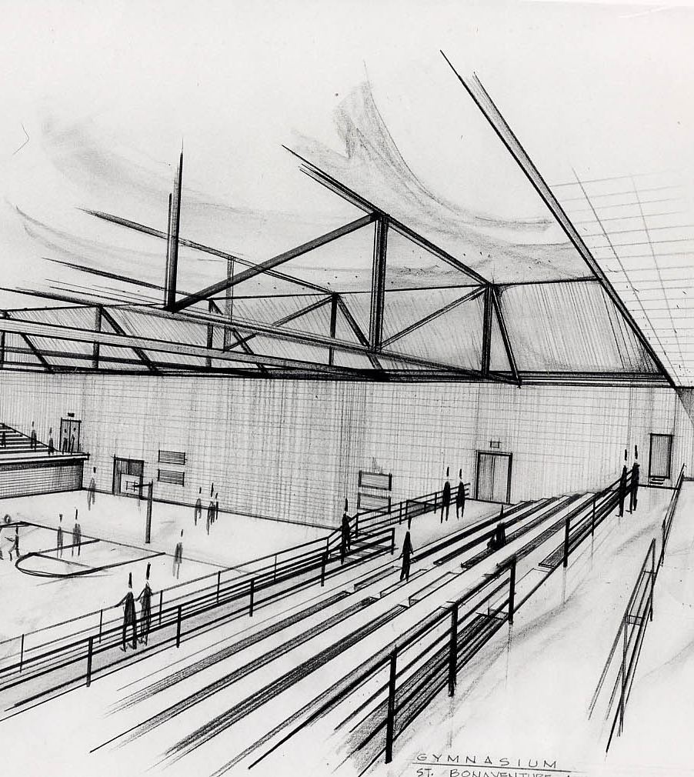
Group activity:
Design a Visitors Centre
This Photo by Unknown Author is licensed under CC BY
Notes:
Recorded introduction. Details of how to do the activity in facilitators notes.
Develop a fun activity suitable for S2-S4 pupils which:
Showcases the role of the heritage sector in society
Gets the students to think about the range of the job profiles mentioned in slide 15 and the hand outs, and the skills and knowledge needed to carry them out
Challenges misconceptions about the skills and knowledge required to work in the heritage sector e.g history buffs
The activity should be flexible enough to be a stand alone lesson or part of extended topic

Slide 17
Working in Heritage
Architect
Volunteer Co-ordinator
Conservation Officer
Events Officer
Archaeologist
Marketing Assistant
Heritage Manager
Conservator
Visitor Assistant
Retail Assistant
Curator
Stone Mason
Admin Assistant
Digital Content Producer
Learning Intern
Notes:
Note: These job roles will have links to either videos (blue) or role profiles.

Slide 18
FIND OUT MORE…
Notes:
Culture and Heritage Quiz
6 multi choice questions, answers are animated

Slide 19
https://www.dyw.scot/discovercreative1.html

Slide 20
My World Of Work
Notes:
Sign post to MyWoW/ DYW resources for further information on sector and future focus.

