Slide 1
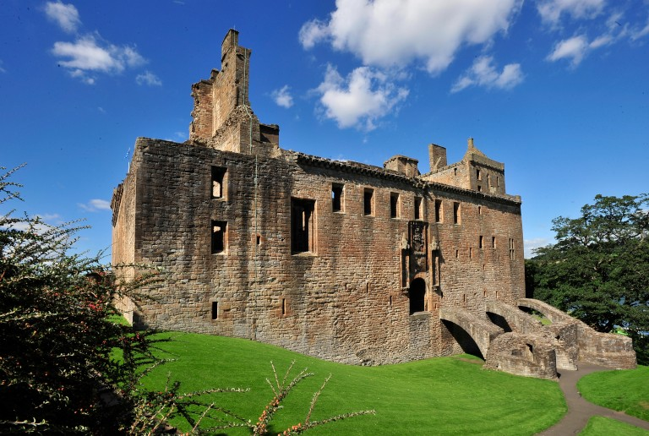
Explore Linlithgow Palace – Film Quiz
Complete this quiz after watching the film
Explore Linlithgow Palace with the Junior Tour Guides to see if you are an expert about royal life there.
www.youtube.com/watch?v=Nk2taAMlTYU
Notes:
https://www.youtube.com/watch?v=Nk2taAMlTYU
Maximum points – 24
008-001-055-341-C Linlithgow Palace © Crown Copyright

Slide 2
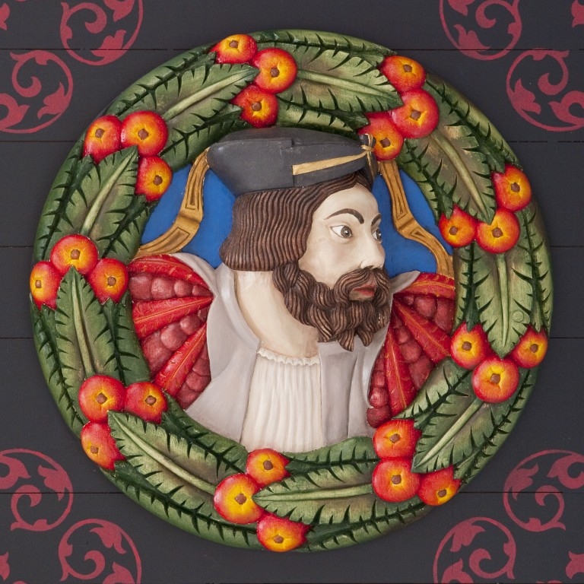
1. What first name were many of the Stewart kings given?
George
B. Henry
C. Sebastian
D. James
Notes:
One point for
D. James
008-001-066-052-C James I © Crown Copyright

Slide 3
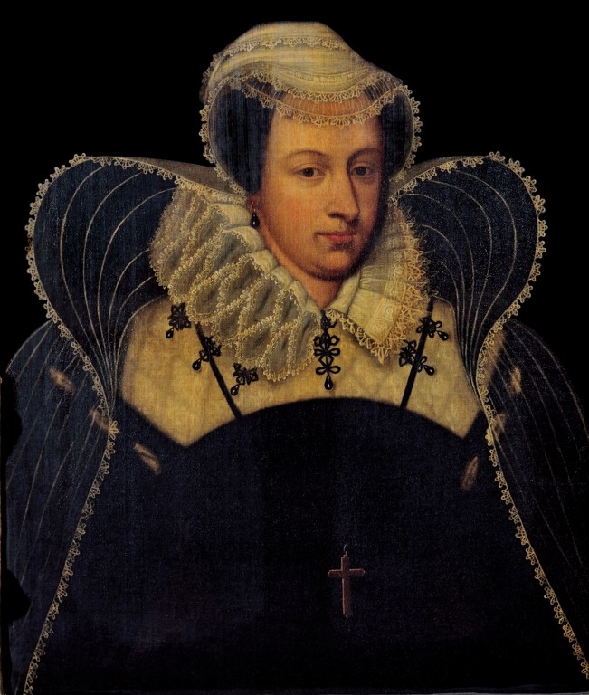
2. What relation was Mary Queen of Scots to
Elizabeth I of England?
Sister
B. Cousin
C. Mother
D. Aunt
Notes:
One point for
B. Cousin
008-000-100-067-C Portrait of Mary Queen of Scots © Crown Copyright

Slide 4
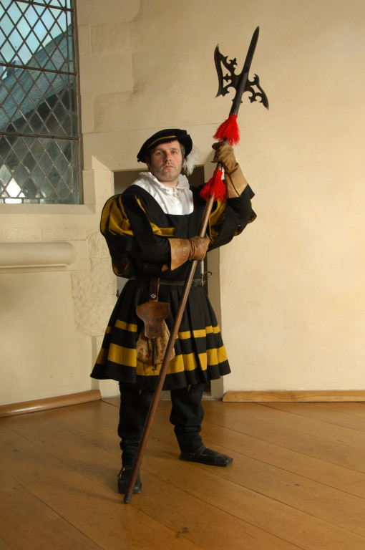
3. Name three ways the guards kept Linlithgow Palace safe:
1?
2?
3?
Notes:
One point for each, up to a maximum of three
Lower and raise drawbridge
Lower and raise portcullis
Checked everyone coming in and out (for weapons),
Patrolled key points around Palace
008-001-012-374-C Portrait of an actor dressed as a castle guard © Crown Copyright

Slide 5
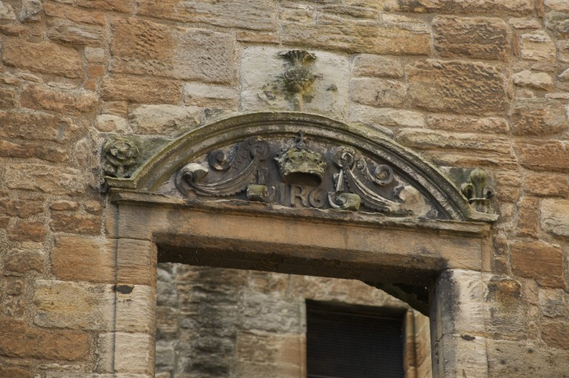
4. Carved flowers representing Scotland, England and France can be seen in the palace courtyard.
Which flower represents Scotland?
Rose
B. Lily
C. Thistle
D. Heather
Notes:
One point for
C. Thistle
008-001-057-837-C A decorated window pediment, Linlithgow Palace © Crown Copyright

Slide 6
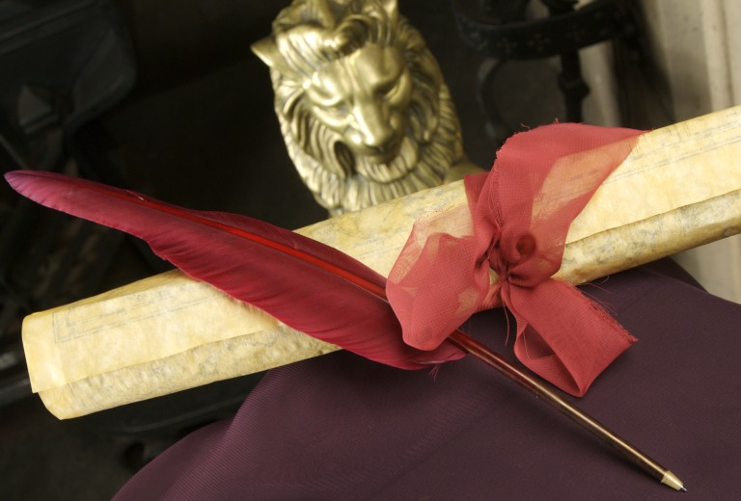
5. Another word for a code was used in the film.
What was it?
Cryptogram
B. Cipher
C. Hieroglyph
D. Encryption
Notes:
One point for
B. Cipher
008-001-004-846-C Scroll and quill pen © Crown Copyright

Slide 7
6. Name two types of code mentioned in the film:
1?
2?
Notes:
One point for each, up to a maximum of two
Caesar cipher,
Backwards writing
Letter swap
008-001-004-846-C Scroll and quill pen © Crown Copyright

Slide 8
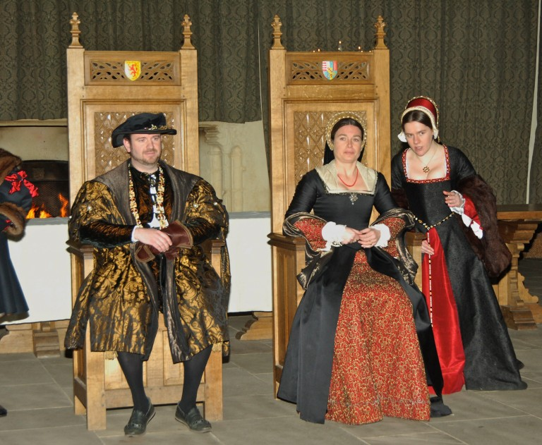
7. Name the gestures that men and women each used when greeting royalty:
Men?
Women?
Notes:
One point each for
Bow
Curtsey
008-001-012-690-C Portrait of an actor and an actress dressed as James V and Mary of Guise © Crown Copyright

Slide 9
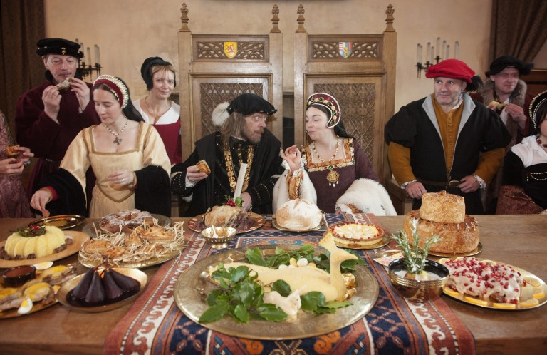
8. Name three rules for sitting at the table at a royal banquet:
1?
2?
3?
Notes:
One point for each, up to a maximum of three
Don’t scratch
Don’t sniff, don’t start eating before King
Stop eating when the King stops
Keep your elbows off the table
008-000-024-928-C Midwinter feast © Crown Copyright

Slide 10
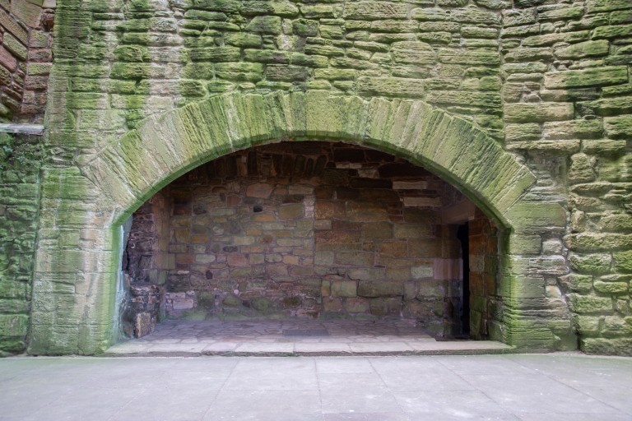
9. Name three jobs in the palace kitchen:
1?
2?
3?
Notes:
One point for each up to a maximum of three
Cook
Turnbrochie,
Kitchen maid
Servants
Cleaners,
Potwashers
008-000-089-347-C Detail of fireplace in upper kitchen of Linlithgow Palace © Crown Copyright

Slide 11
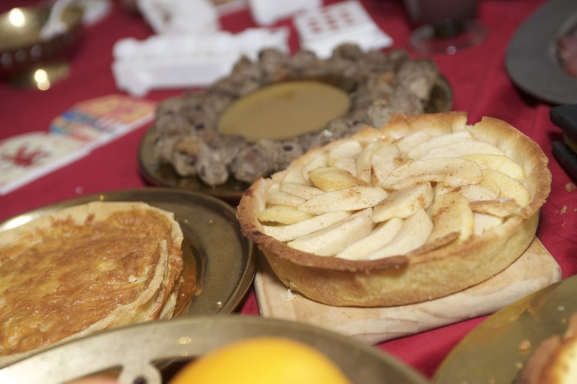
10. Name three dishes the cooks were preparing for the feast:
1?
2?
3?
Notes:
One point for each up to a maximum of three, plus two bonus points
Roast peacock (stuffed with mallard & teal for bonus point!)
Swan (stuffed with capon, pigeon & robin for bonus point)
Pies ( tongue and mutton)
Trout/trout pastries
Points can be given for roast meats, pies and fish without naming the types
008-000-056-662-C Royal feast food © Crown Copyright

Slide 12
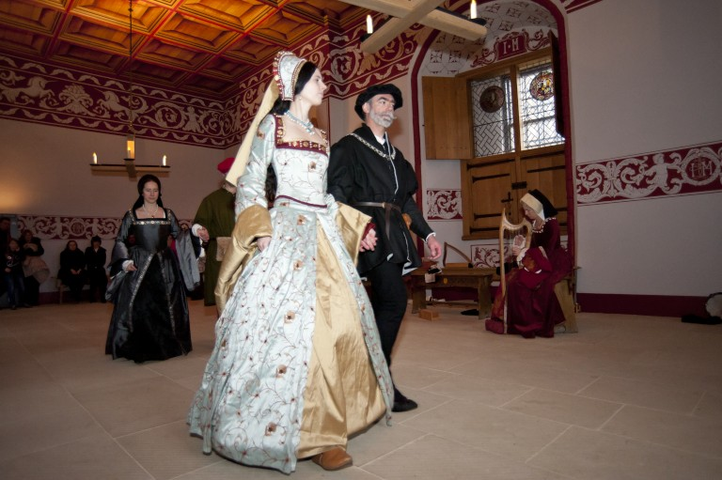
11. Which dance did the junior guides demonstrate in the film?
Brass
B. Basse
C. Boss
D. Brace
Notes:
One point for
B. Basse
008-001-073-158-C Royal Stewart court dance © Crown Copyright

Slide 13
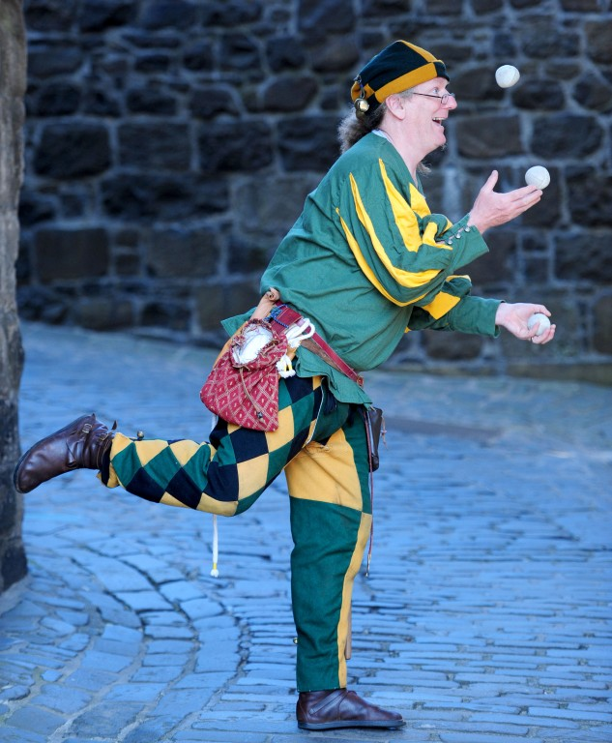
12. Which of these types of Great Hall entertainment was not mentioned in the film?
High wire walking
B. Juggling
C. Acrobatics
D. Dancing
Notes:
One point for
High wire walking
008-000-011-013-C Juggler © Crown Copyright

Slide 14
Explore Linlithgow Palace – Quiz Answers 1-3
Question 1 (1 point)
Many of the Stewart Kings were called James (option D).
Question 2 (1 point) – Mary Queen of Scots was Elizabeth I of England’s cousin (option B).
Question 3 (1 point each, up to a maximum of 3)
Guards kept Linlithgow Palace safe by:
Lowering and raising the drawbridge
Lowering and raising the portcullis
Checking everyone coming in and out (for weapons)
Patrolling key points around the Palace
Notes:
008-001-066-052-C James I © Crown Copyright
008-000-100-067-C Portrait of Mary Queen of Scots © Crown Copyright
008-001-012-374-C Portrait of an actor dressed as a castle guard © Crown Copyright

Slide 15
Explore Linlithgow Palace – Quiz Answers 4-6
Question 4 (1 point)
The thistle represents Scotland (option C)
Question 5 (1 point)
Another word for a code is a cipher
Question 6 (1 point each, up to a maximum of 2)
Some types of codes include:
Caesar cipher
Backwards writing
Letter swap
Notes:
008-001-057-837-C A decorated window pediment, Linlithgow Palace © Crown Copyright
008-001-004-846-C Scroll and quill pen © Crown Copyright

Slide 16
Explore Linlithgow Palace – Quiz Answers 7-8
Question 7 (1 point each)
Men would bow and women would curtsey when meeting royalty
Question 8 (1 point each, up to a maximum of 3)
Table manner rules at banquets included:
Don’t scratch
Don’t start eating before King
Stop eating when the King stops
Don’t sniff
Keep your elbows off the table
Notes:
008-001-012-690-C Portrait of an actor and an actress dressed as James V and Mary of Guise © Crown Copyright
008-000-024-928-C Midwinter feast © Crown Copyright

Slide 17
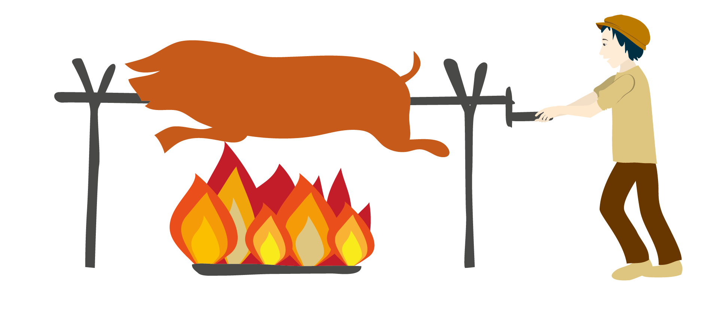
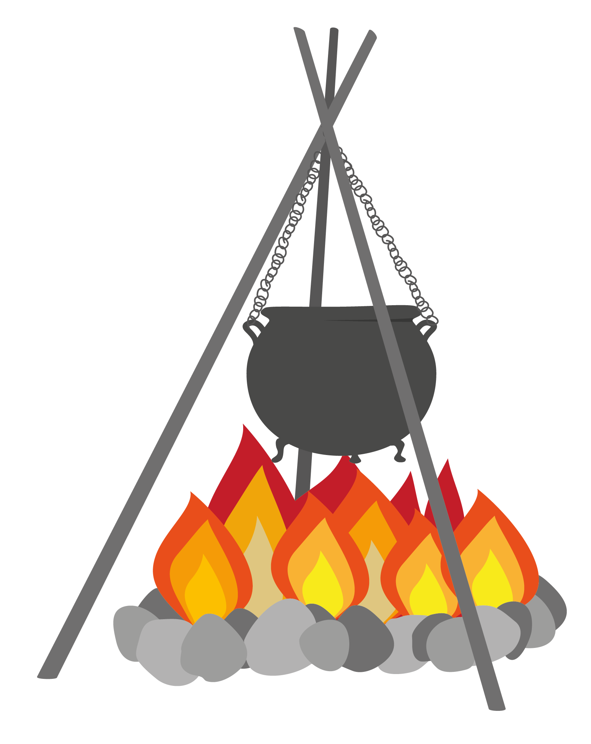
Explore Linlithgow Palace – Quiz Answers 9
Question 9
(1 point each, up to a maximum of 3)
Jobs in the palace kitchen included:
Cook
Turnbrochie
Kitchen maids
Servants
Cleaners
Potwashers
Notes:
008-000-089-347-C Detail of fireplace in upper kitchen of Linlithgow Palace © Crown Copyright
Turnbrochie and cauldron and fire illustrations by Helen Wyllie

Slide 18
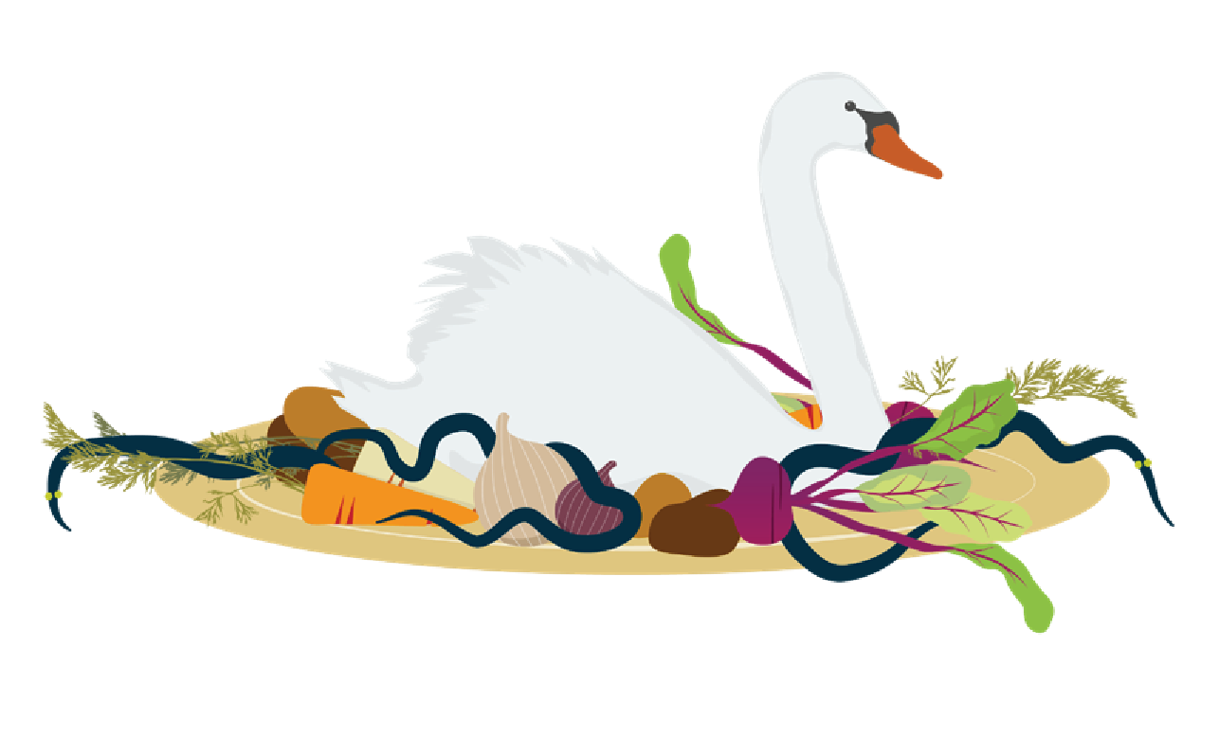
Explore Linlithgow Palace – Quiz Answers 10
Question 10
(1 point each up to a maximum of 3, plus up to 2 bonus points if you remembered the stuffing!)
The cooks were preparing:
Roast peacock (stuffed with mallard & teal for bonus point!)
Swan (stuffed with capon, pigeon & robin for bonus point!)
Pies (tongue and mutton)
Trout/trout pastries
Points can be given to answers like ‘Roast meats’, ‘pies’ and ‘fish’ without naming the types of meat/fish.
Notes:
008-000-056-662-C Royal feast food © Crown Copyright
008-001-073-158-C Royal Stewart court dance © Crown Copyright
008-000-011-013-C Juggler © Crown Copyright

Slide 19
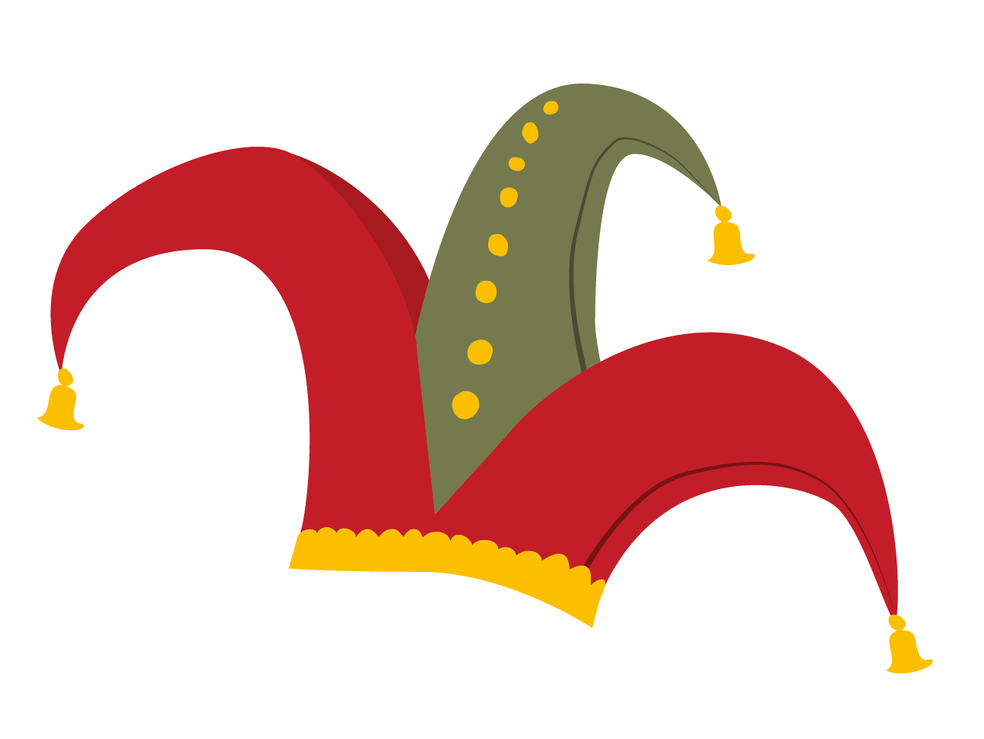
Explore Linlithgow Palace – Quiz Answers 11-12
Question 11 (1 point)
The Junior Tour Guides were demonstrating the Basse dance (option B)
Question 12 (1 point)
High wire walking (option A) was not mentioned as a type of entertainment that would have been found in Linlithgow Palace’s Great Hall.
Notes:
008-001-073-158-C Royal Stewart court dance © Crown Copyright
008-000-011-013-C Juggler © Crown Copyright

Slide 20
Well done!
Time to add up your points.
Where will you be during a feast in the Great Hall?
0-5 points Collecting the rubbish 6-10 points Chopping vegetables
11-15 points Eating the leftovers
16-20 points Sitting at the top table
20-24 points On the royal throne
Explore Linlithgow Palace – Film Quiz
Notes:
Maximum points – 24
008-001-055-341-C Linlithgow Palace © Crown Copyright

