Slide 1
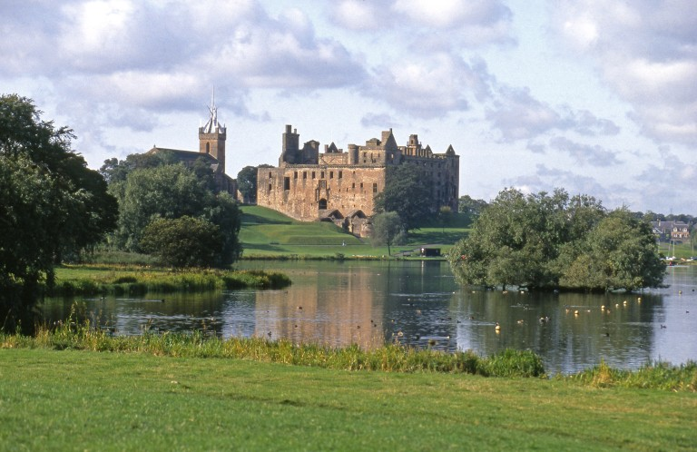
Explore Linlithgow Palace – Assembly Images
Notes:
008-001-026-521-C View of Linlithgow Palace from the east, looking across Linlithgow Loch. © Crown Copyright

Slide 2
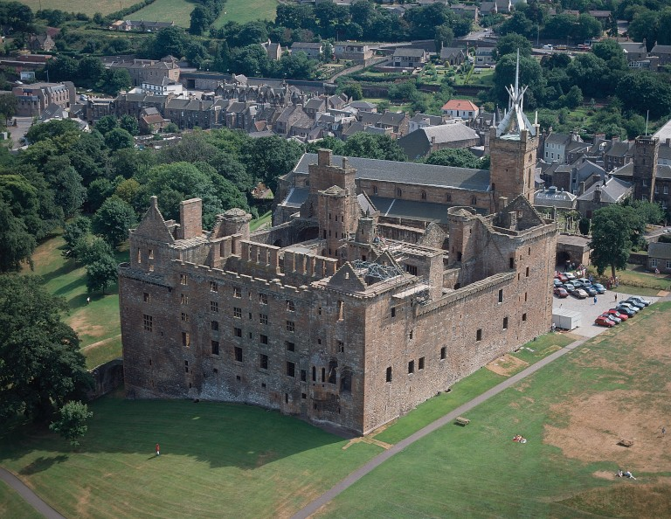
Explore Linlithgow Palace – Image 1
This is an aerial image of Linlithgow Palace.
Notes:
008-001-001-122-C Aerial view of Linlithgow Palace. © Crown Copyright

Slide 3
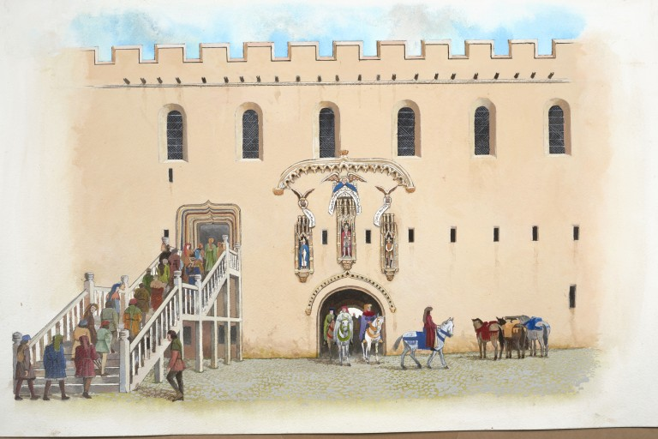
Explore Linlithgow Palace – Image 2
This is an illustration of one of the oldest parts of the palace, the east quarter, built by James I. It shows the formal stair which led up to his Great Hall.
Notes:
008-000-089-706-C Illustration of the east quarter in around 1430 showing the formal stair which led up to James I's first-floor Great Hall at Linlithgow Palace. © Crown Copyright

Slide 4
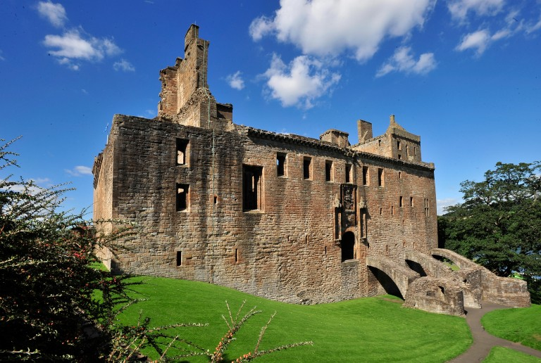
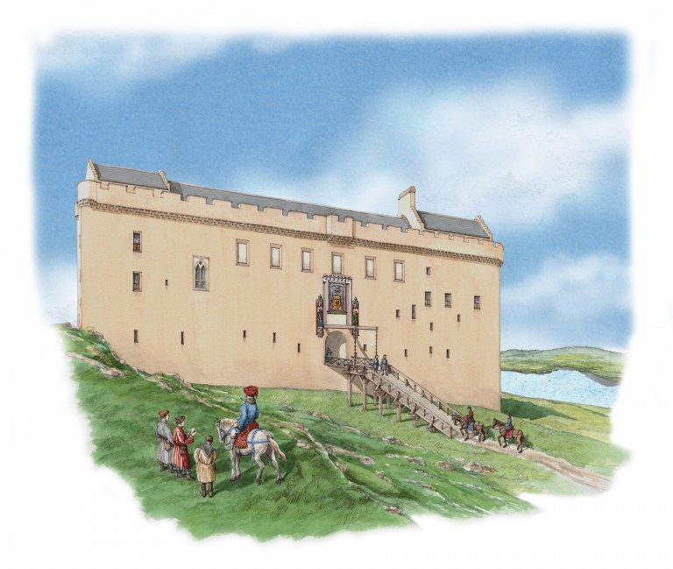
Explore Linlithgow Palace – Image 3
This is a photo and an illustration of the oldest entry to Linlithgow Palace, showing the drawbridge on the east side.
Notes:
008-001-055-341-C General view of the east front of Linlithgow Palace. © Crown Copyright
008-000-091-853-C An artist's impression of James I inspecting progress on his new palace at Linlithgow in summer 1434. © Crown Copyright

Slide 5
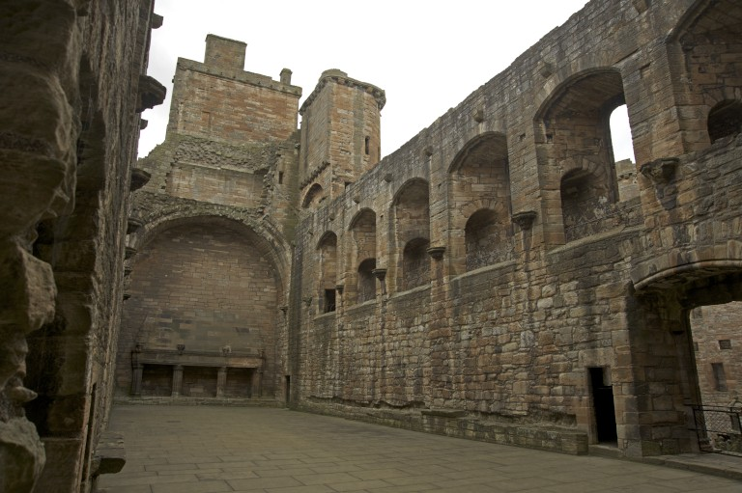
Explore Linlithgow Palace – Image 4
This is an image of the Great Hall as it looks today.
Notes:
008-001-056-983-C Interior view of the east range of Linlithgow Palace showing the fireplace in the Great Hall. © Crown Copyright

Slide 6
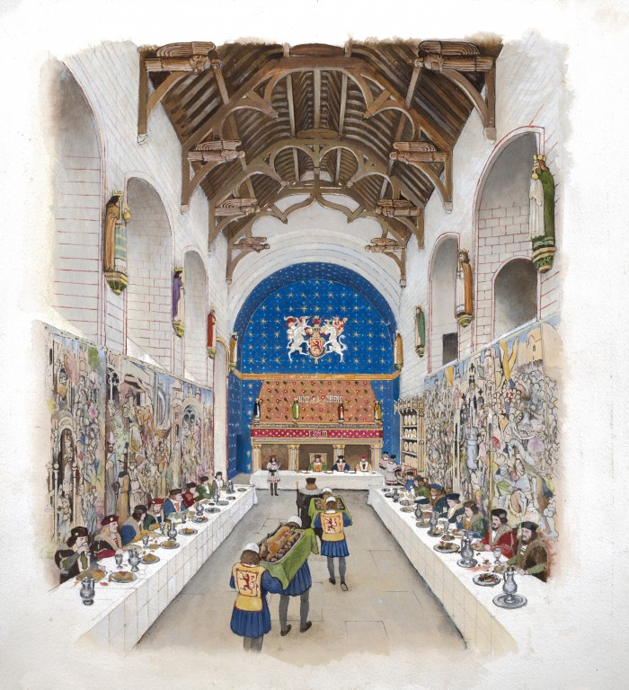
Explore Linlithgow Palace – Image 5
This is an artist's impression of how the Great Hall at Linlithgow Palace looked during the Easter feast of 1512.
Notes:
008-000-089-708-C An artist's impression of the Easter feast of 1512 taking place in the Great Hall at Linlithgow Palace. © Crown Copyright

