Slide 1
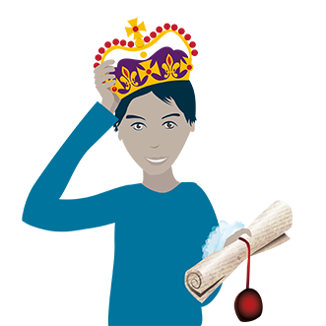
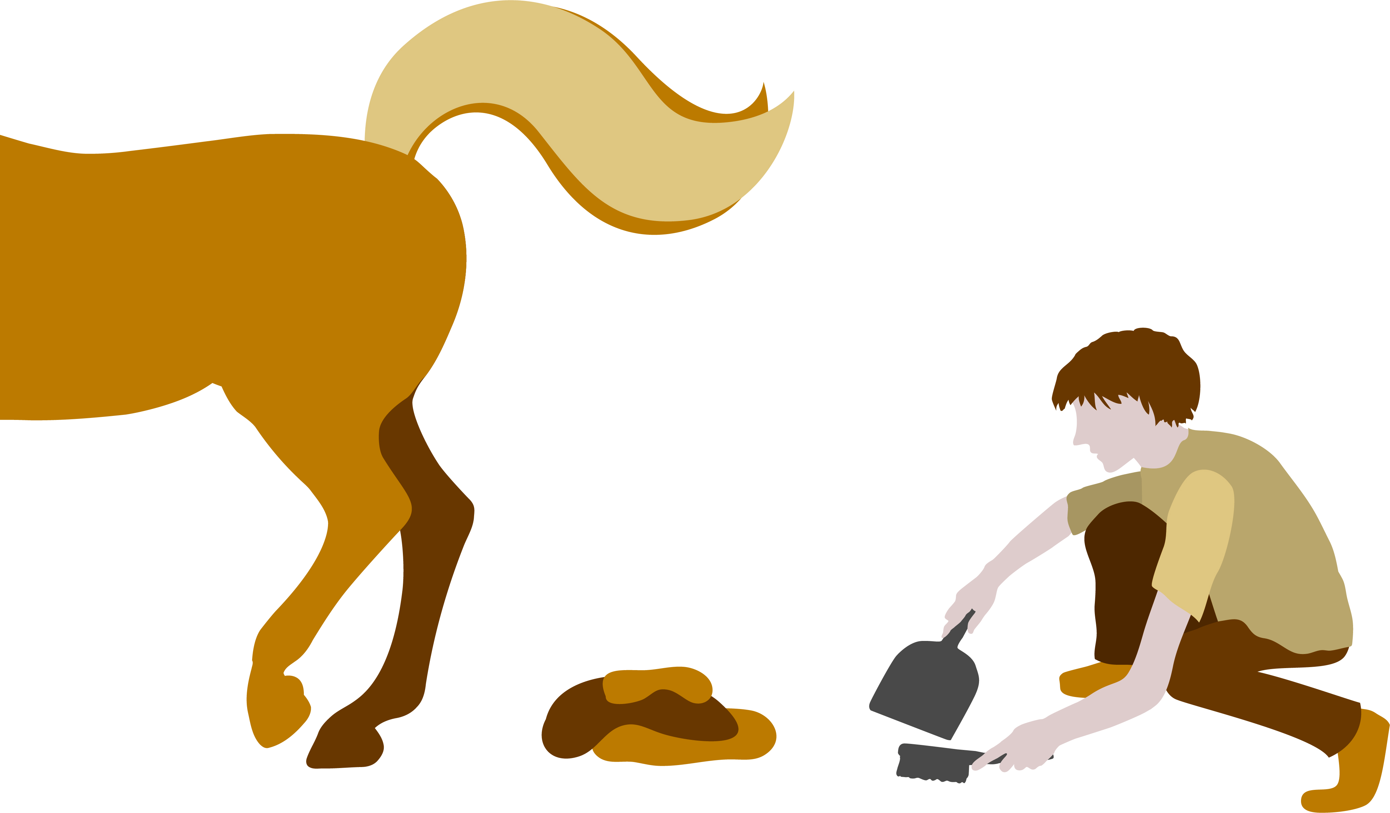
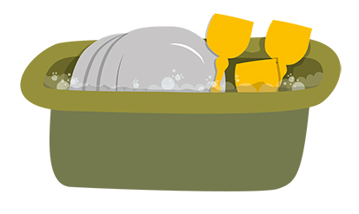
A persuasion game for groups of 3 - 5 people
Based on a game developed by Lisa Wilson for

Slide 2
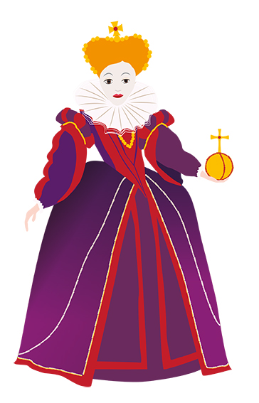
Playing in groups, you are going to interview each other for different jobs in a medieval Scottish castle.
Convince the interviewer you’re the best person for the job!
Each interviewer will have around 5 minutes per round to interview all the group members for the job.

Slide 3
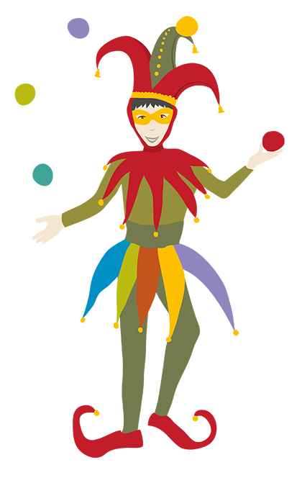
First… In each group, decide who is Player A, B, C, D (optional) and E (optional)
You can play up to 5 rounds, so everyone can have a turn of being the interviewer.

Slide 4
Round 1: Player A is the interviewer
Falconer: Someone who breeds and trains birds like hawks and falcons to hunt other birds and animals. You look after them carefully, hand-raising them from chicks.
Players, your special skills / personality traits / unique qualities are...
Player B
You have excellent time keeping
You’re good at cleaning up
You don’t mind blood and guts
Player C
You have a loud speaking voice
You own lots of hats
You’ve got good hearing
Player D
You’re good at finding lost things
You’re careful about small details
You’re a good singer
Player E
You’re good at remembering names
You’re tough with good stamina
You’re very patient
Interviewer, ask the players one-by-one why they would be good at this.

Slide 5
Player A, it is time to decide.
Who will be the castle’s new falconer?
Congratulations on your new job!
Next up as interviewer, player B…

Slide 6
Round 2: Player B is the interviewer
Turn-Spit: Someone, usually a child, who helps roast animals for feasts by turning the handle of the ‘spit’, the machine used to roast meat over a fire.
Players, your special skills / personality traits / unique qualities are...
Player A
You’re a good singer
You can go for ages without a pee
You’re good at lying
Player C
You’re sneaky
You love being helpful
You’re a very messy person
Player D
You’re a fast runner
You make friends easily
You never ask questions
Player E
You’re scared of the dark
You’re reliable
You’re good at remembering names
Interviewer, ask the players one-by-one why they would be good at this.

Slide 7
Player B, it is time to decide.
Who will be the castle’s new falconer?
Congratulations on your new job!
Next up as interviewer, player C…

Slide 8
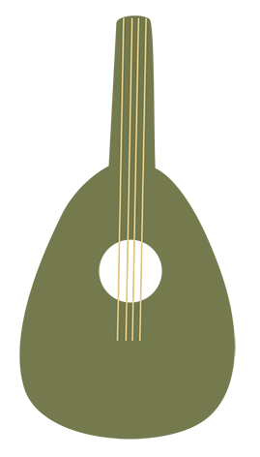
Round 3: Player C is the interviewer
Bard: Someone who writes silly, serious or romantic songs and poems to entertain people during feasts and in the evenings.
Players, your special skills / personality traits / unique qualities are...
Player A
You own a lot of hats
You’re good at keeping secrets
You’re good at sewing
Player B
You’re good at thinking of rhymes
You’re good at saving money
You don’t mind loud noises
Player D
You’re very good at maths
You love fancy dress
You always feel important
Player E
You have a good imagination
You can read and write
You own many disguises
Interviewer, ask the players one-by-one why they would be good at this.

Slide 9
Player C, it is time to decide.
Who will be the castle’s new falconer?
Congratulations on your new job!
Next up as interviewer, player D…

Slide 10
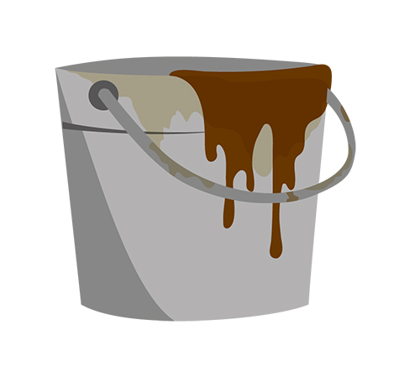
Round 4: Player D is the interviewer
Gong farmer: A person who shovels out the contents of the cesspits and privies (the toilets) and takes it outside the walls for disposal.
Players, your special skills / personality traits / unique qualities are...
Player A
You can’t tell the time
You’re very strong
Animals hate you
Player B
You’re don’t get bored easily
You don’t mind blood and guts
You can see well in the dark
Player C
You own a shovel
You hate crowds
You’re a very bad dancer
Player E
You know how to tie lots of knots
You have no sense of smell or taste
You get up early in the morning
Interviewer, ask the players one-by-one why they would be good at this.

Slide 11
Player D, it is time to decide.
Who will be the castle’s new falconer?
Congratulations on your new job!
Next up as interviewer, player E…

Slide 12
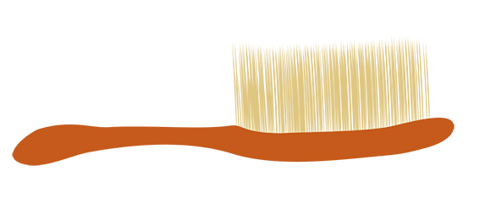
Round 5: Player E is the interviewer
Lady’s maid: An important servant who helps rich women dress, do their hair, and look after their clothes. You might also help with other chores around the castle.
Players, your special skills / personality traits / unique qualities are...
Player A
You’re always in a good mood
You work very quickly
You like noise and excitement
Player B
You’re very quiet
You’re happy to eat kitchen scraps
You have a good memory
Player C
You’re always very polite
You can stay awake all night
You love fire
Player D
You’ve got very steady hands
You don’t mind being in small spaces
You’re extremely tall
Interviewer, ask the players one-by-one why they would be good at this.

Slide 13
Player E, it is time to decide.
Who will be the castle’s new falconer?
Congratulations on your new job!

Slide 14
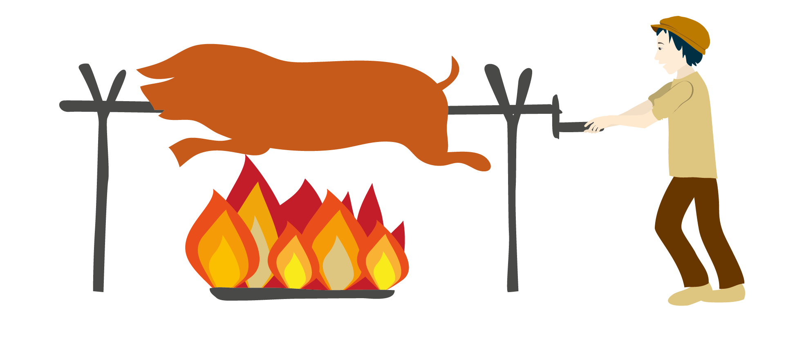
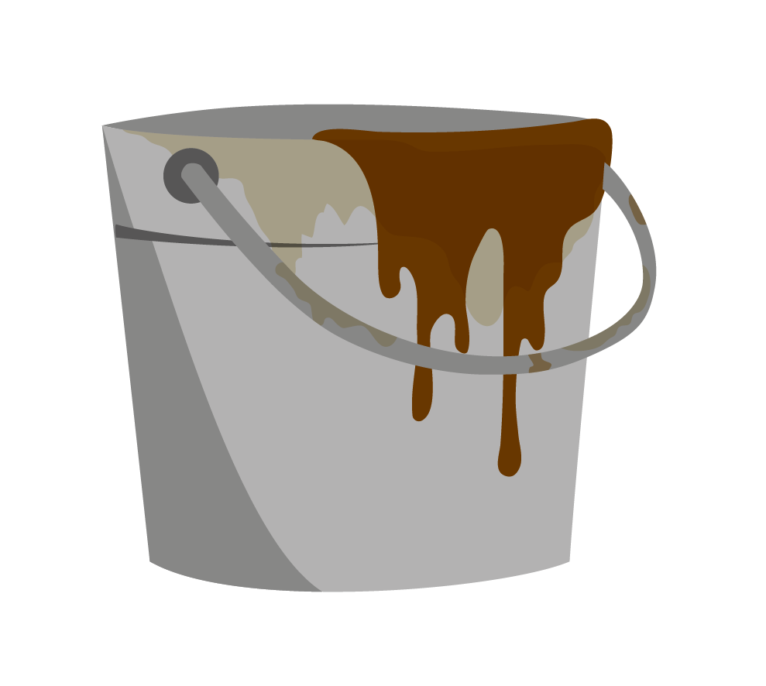
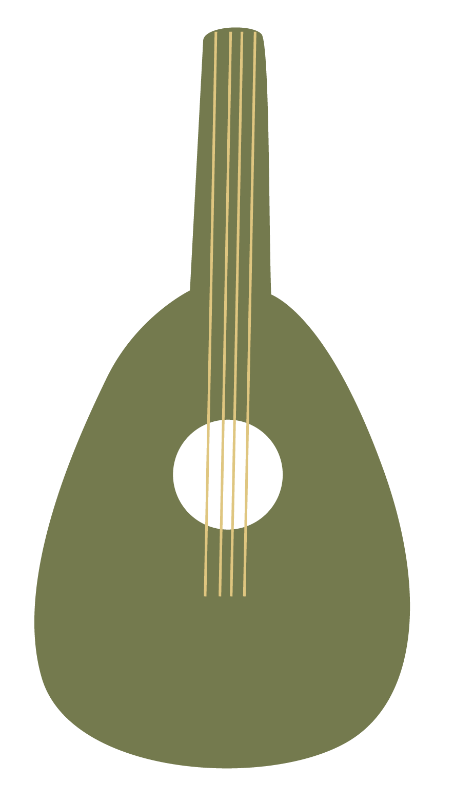
Thanks for playing!
If you had to pick from these jobs, which one would you choose and why?
Falconer
Turn-spit
Lady’s maid
Bard
Gong
Farmer
Would you work in a team or independently?
What would be the most interesting part of this job? How about the least?
Do you have all the right skills now? What would you need to work on?

Slide 15
If you would like to learn about jobs looking after castles today, have a look at our careers pack or our short films about the roles of visitor welcome staff and conservation staff.
This game is also available as a print-at-home card game
Keen for more? Take a look at all our free learning resources at historicenvironment.scot/learn

