Slide 1
Defending Scotland’s Heritage Project

Slide 2
Who are Historic Environment Scotland (HES)?
We are the lead organisation that investigate, care for and promote Scotland’s historic environment.
Our mission is to:
enhance knowledge and understanding of Scotland’s historic environment
protect, conserve and manage the historic environment for the enjoyment, enrichment and benefit of everyone – now, and in the future
share and celebrate our cultural heritage with the world

Slide 3
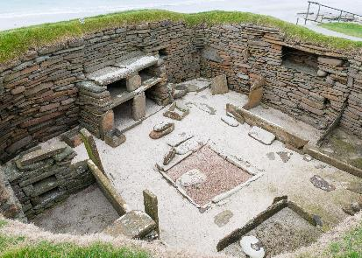
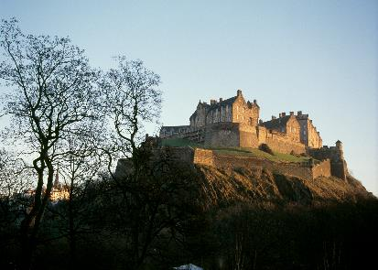
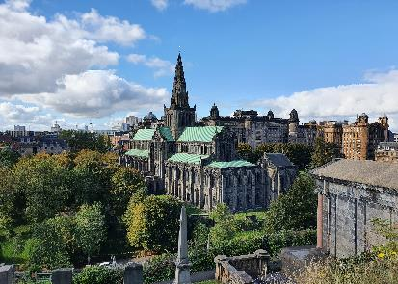
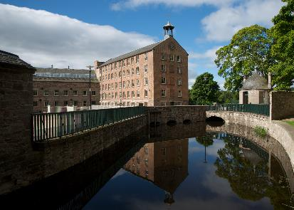
HES properties
HES care for different types of properties.
Prehistoric places
Castles
Abbey’s and Cathedrals
Industrial buildings
Notes:
Top left: 008-000-017-015-C: Skara Brae; © Crown Copyright HES
Top right: 008-001-004-683-C: Edinburgh Castle; © Crown Copyright HES
Bottom left: 008-000-093-915-C: Glasgow Cathedral; © Historic Environment Scotland.
Bottom right: 008-001-017-374-C: Stanley Mills; © Crown Copyright HES

Slide 4
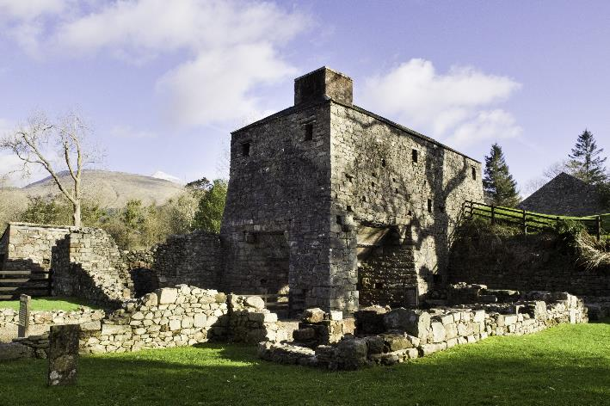
What is heritage?
Historic buildings are one example.
Can you think of others?
Discuss in pairs or groups what the definition of “heritage” is.
To explore further, try the activities in the What is heritage powerpoint.
Bonawe Iron Furnace, Argyll.
Notes:
008-001-079-160-C: Bonawe Iron Furnace © Crown Copyright HES.

Slide 5

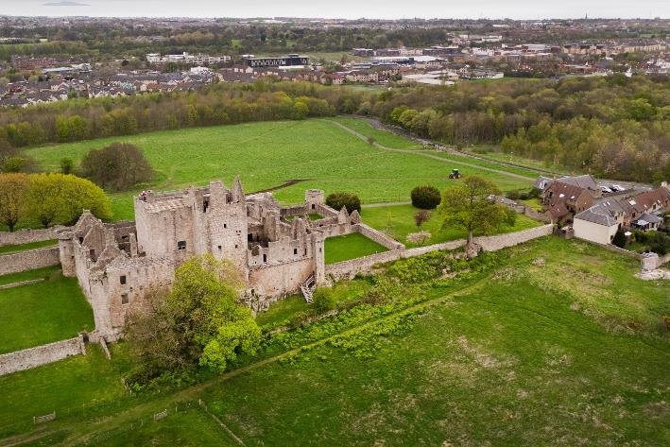
Local heritage
Historic sites and places can help create a sense of identity.
Their stories connect us to where we come from.
They might be places we walk past every day and don’t really notice.
But if they were destroyed or lost, part of the identity of the town, city or village would be lost.
Top: Craigmillar’s local primary school use the castle in their logo and school website.
Bottom: Craigmillar Castle and the local area, Edinburgh.
Notes:
008-000-066-625-C: Craigmillar Castle and area © Historic Environment Scotland.

Slide 6
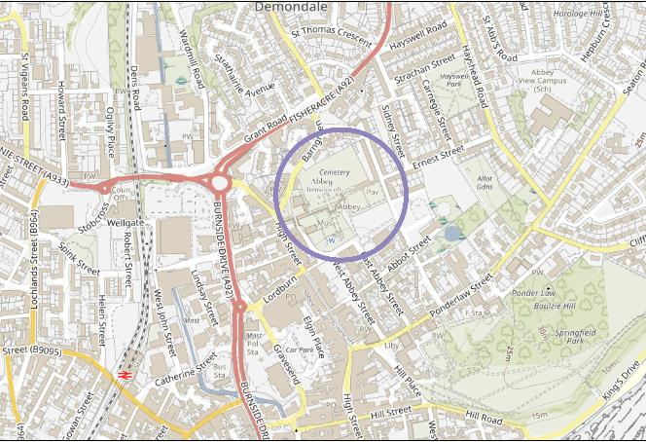
Your local site
Do you have a historic place where you live?
Find it on a map.
What do you notice about where it is and the landscape that surrounds it?
Have you visited it?
What do you know about it?
Find out 10 facts about your site and share them with your group.
Map of Arbroath.
Notes:
Map of Arbroath (modern OS map) reproduced by permission of the National Library of Scotland.

Slide 7
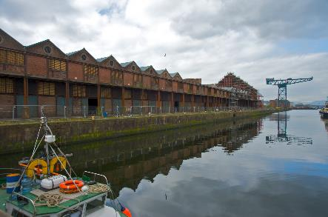
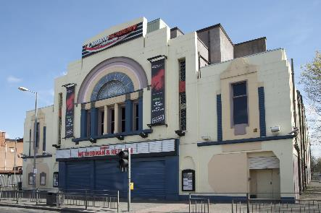
Resources
Not sure what’s in your area? Try the activities in the Exploring Local Identity resource.
National Map Library
Past Map
Canmore maps
Canmore image library
Scran image library
Britain from Above
Archaeology Scotland
Notes:
008-001-034-718-C: Raw Sugar Warehouse conversion, James Watt Dock, Greenock. © HES
008-001-019-062-C: Carling Academy, 117 Eglinton Street, Glasgow. This was previously the New Bedford cinema and, after that, a bingo hall. © HES

Slide 8
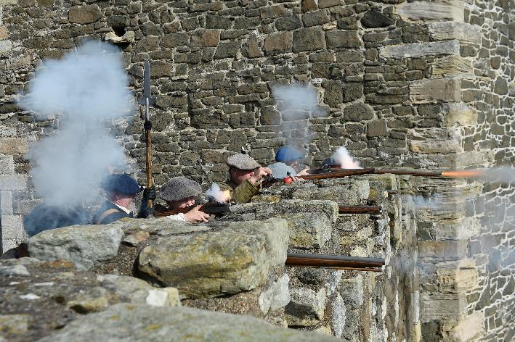
Heritage under attack!
In the past…
Historic sites like churches, castles or abbeys could come under attack from:
rival families or enemy armies who wanted to capture them or destroy them during a war
weather and age, causing parts to wear away or collapse
Re-enactors defending a castle.
Notes:
008-000-037-157-C: Re-enactment of an attack on a castle; © Greg Macvean

Slide 9
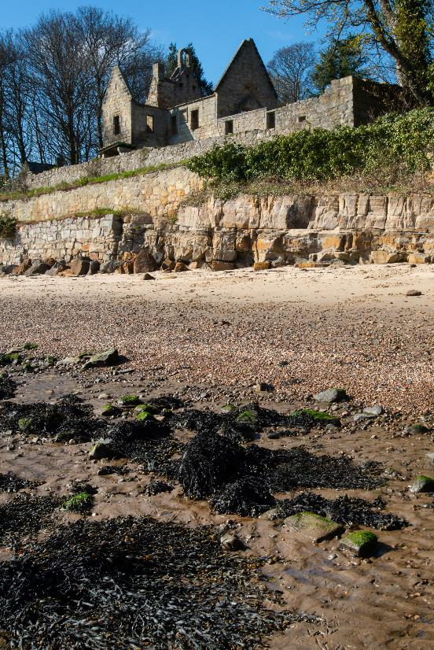
Today…
Historic places are also under attack now.
The threats might be local and/or global and might be linked to:
where the site is
what it is made of
how it is looked after
what people think about it
Discuss as a class what you think the main threats to your local site might be.
Notes:
008-000-082-000-C: St Bridget’s Kirk; ©Historic Environment Scotland

Slide 10
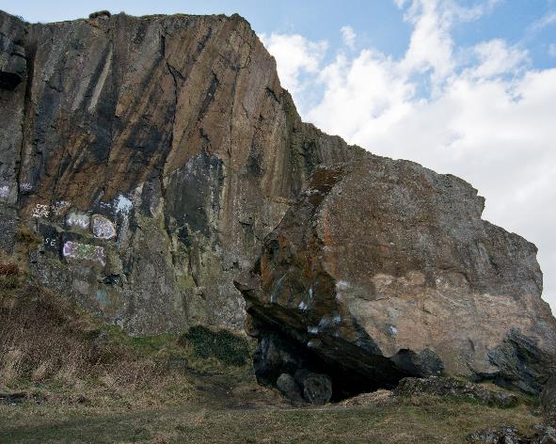
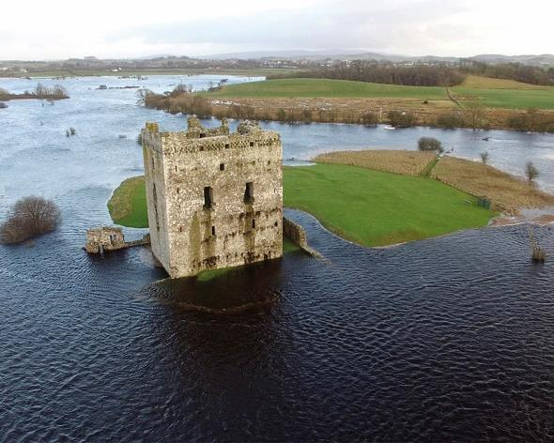
Modern threats
Heritage crime
Climate change
Notes:
Left: 008-000-032-786-C: Graffiti at Dumbarton © Crown Copyright HES
Right: 008-000-110-426-C: Threave Castle © Historic Environment Scotland

Slide 11
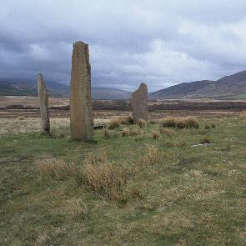
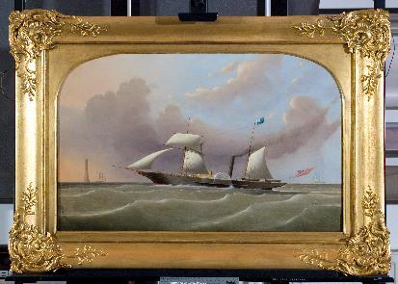
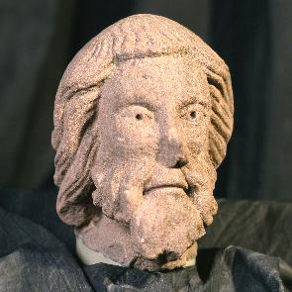
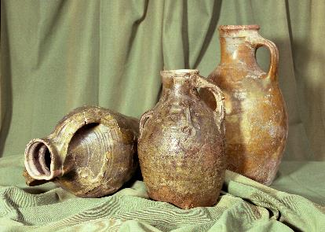
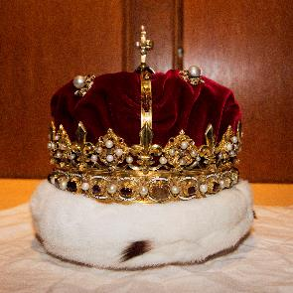
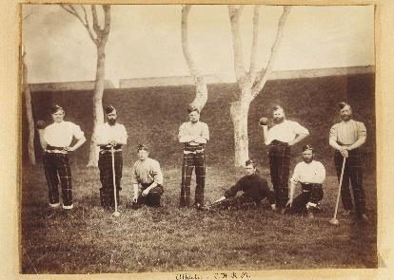
Heritage crime
Did you know…
that Scotland’s historic places are protected by law?
Heritage crime is any criminal activity which causes damage to what we call historic assets.
An asset is something which is valuable.
What sort of things might be historically valuable or important assets?
Notes:
See also Defending Scotland’s Heritage- Heritage Crime Activity sheet.
Top left: 008-001-043-457-C Standing stones, Machrie Moor Castle © Crown Copyright HES
Top right: 008-001-047-094-C Painting, Trinity House © Crown Copyright HES
Middle left: 008-001-001-443-C Sculpture, Melrose Abbey © Crown Copyright HES
Middle right: 008-001-012-056-C Pottery from Caerlaverock Castle © Crown Copyright HES
Bottom left: 008-000-034-980-C Crown Jewels, Edinburgh Castle © Crown Copyright HES
Bottom right: 008-001-050-000-C Archive photograph, Fort George © Crown Copyright HES

Slide 12
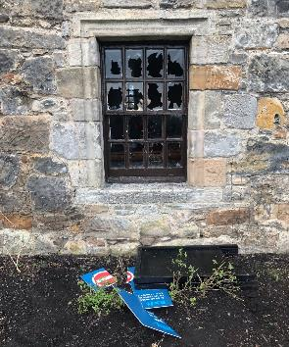

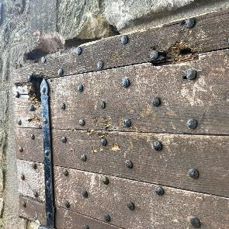
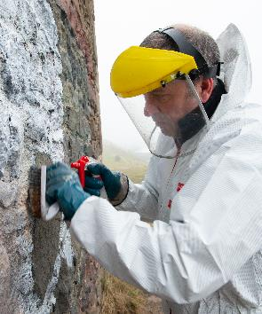
Heritage crime has been increasing
Find out more with our heritage crime activity sheet.
Notes:
Top: Broken window, Aberdour Castle © HES staff
Middle: Damage to entrance at Craigmillar Castle © HES
Bottom: Graffiti being cleaned off a structure in Holyrood Park © HES

Slide 13
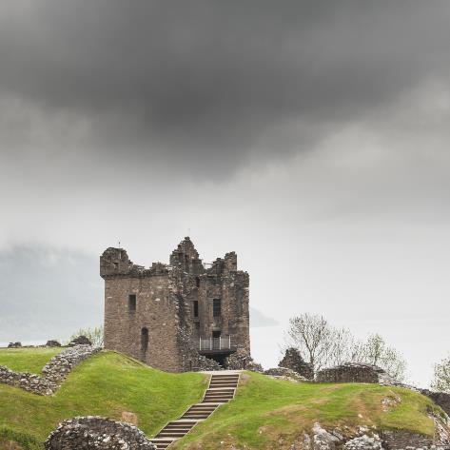
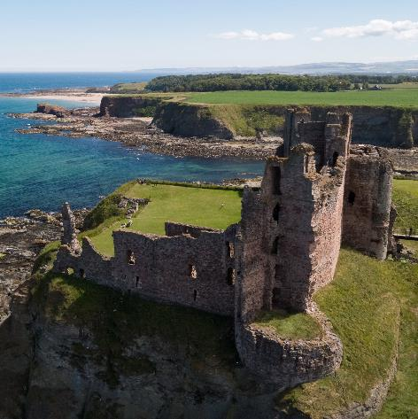
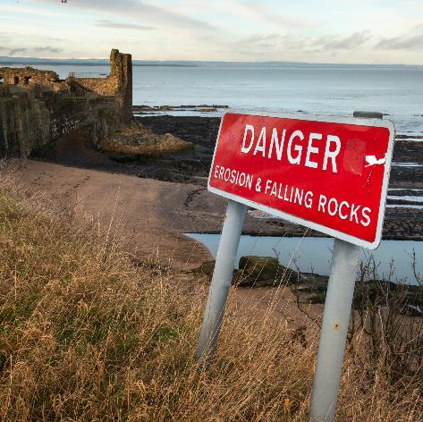
Climate change
As a result of climate change, Scotland is facing hotter, drier summers and warmer, wetter winters.
This all has an impact on our historic sites.
Wet weather can lead to
stonework decaying faster or being damaged by more weeds and plants growing
flooding or the ground becoming waterlogged
Notes:
See the Climate change fact and activity sheets.
Suggested links:
What does the climate crisis mean for Scotland’s heritage? - YouTube
Climate Change in Scotland: Assessing the Risks – YouTube
On The Front Line - Climate Change Impacts on the Historic Environment - YouTube
Left: 008-001-079-437-C Urquhart Castle; © Crown Copyright HES
Middle: 008-000-069-102-C Tantallon Castle © Historic Environment Scotland
Right: 008-000-089-007-R St Andrews Castle; © Crown Copyright HES

Slide 14
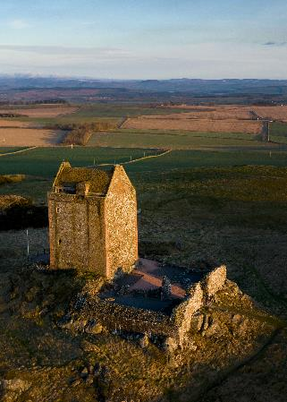
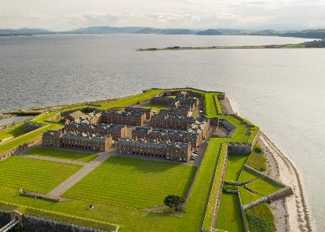
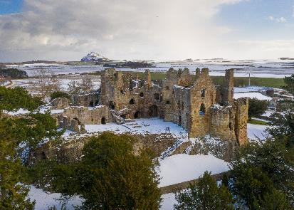
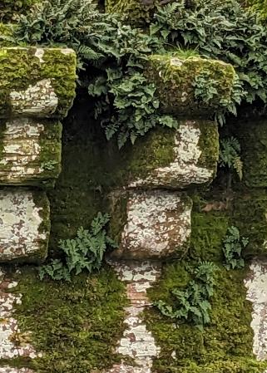
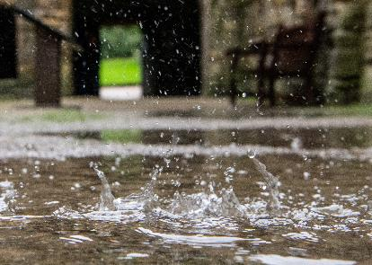
Climate change and your local site
In what ways might climate change affect your local site?
Think about:
its location
how intact it is
whether it is wind and watertight.
To learn more, try the climate change activity
Notes:
Top left: 008-000-095-635-R: Smailholm Tower © Historic Environment Scotland
Top right: FG-008-000-085-226-R: Fort George © Historic Environment Scotland
Middle right: 008-000-096-691-R: Direlton Castle © Historic Environment Scotland
Bottom left: 008-000-119-558-R: Caerlaverock Castle © Historic Environment Scotland
Bottom right: 008-000-101-054-R: Inchcolm Abby © Historic Environment Scotland

Slide 15
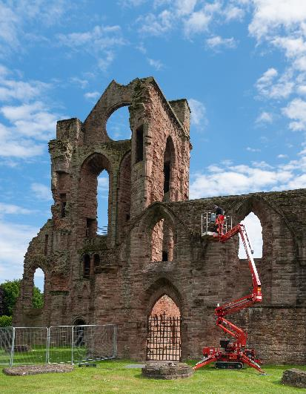
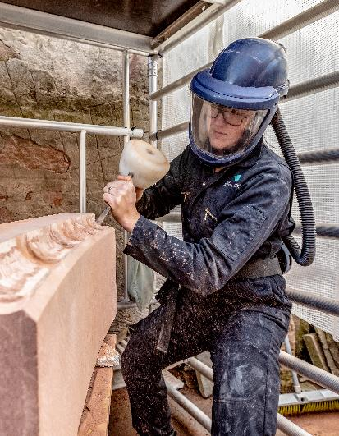
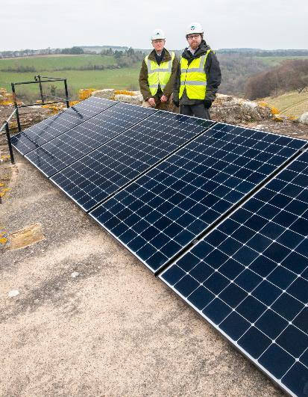
Modern defences
Conservation
Careers
Sustainability
Notes:
Left: 008-000-110-990-R Historic Environment Scotland
Middle: 008-000-079-988-R © Historic Environment Scotland
Right: 008-000-078-013-R: © New Wave Images

Slide 16
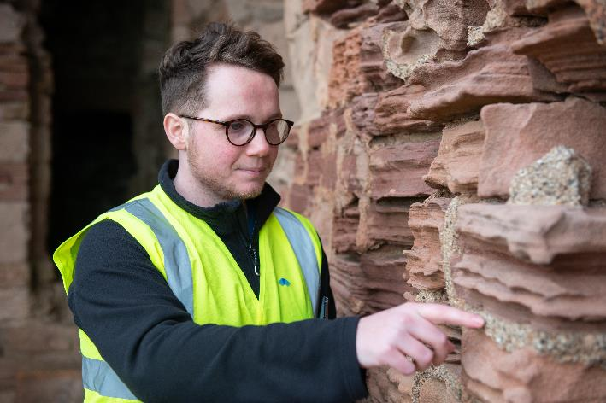
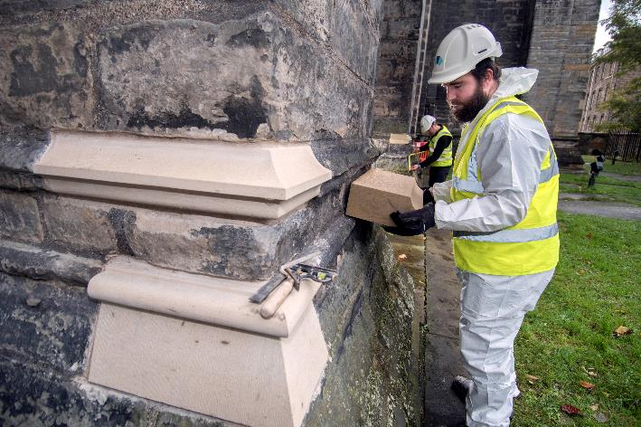
Conservation
Some of our historic places are thousands
of years old.
As well as being well-built in the first place, they are still standing because of the ongoing maintenance work and repair (conservation) that HES carries out to make sure they will still be there in the future.
Notes:
008-000-080-019-C: Examining eroded sandstone at Tantallon Castle; © Historic Environment Scotland.
008-000-058-120-C: Stone replacement at Glasgow Cathedral; © Donald MacLeod

Slide 17
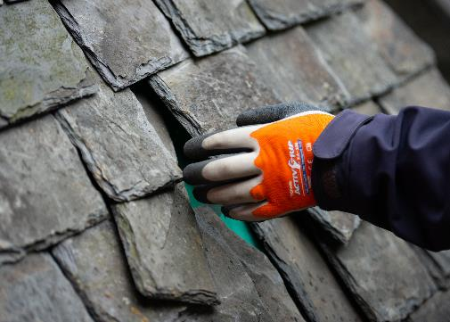
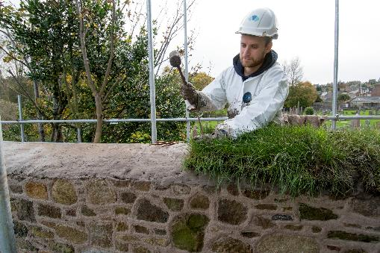
Types of conservation work
Conservation work protects places which are important to us and can involve:​
developing new ways to protect and repair sites (for example, using living plants on the tops of walls protects stonework from extremes of temperature and rainwater​)
making sure that sites don’t suffer any further damage – whether that’s accidental or deliberate, from humans or nature
Top: Replacement of roof slates
Bottom: Soft capping of a wall of the top of a wall using turf.
To learn more, try the conservation activity
Notes:
Suggested links:
Building a future for our past: conservation and education at the Engine Shed – YouTube
008-000-090-164-C - slate replacement on a roof; © Historic Environment Scotland
008-000-057-762-C – turf capping at Melrose Abbey; © Donald MacLeod

Slide 18
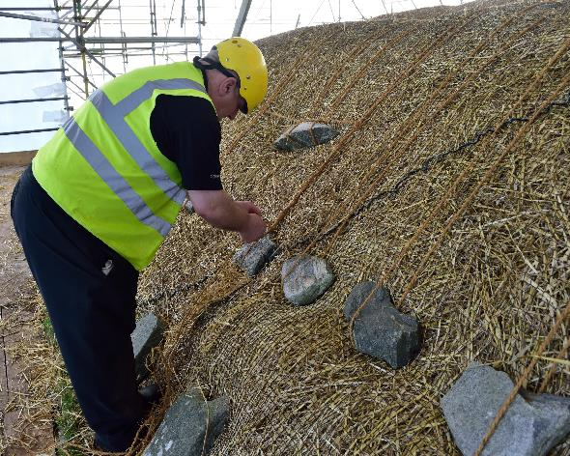
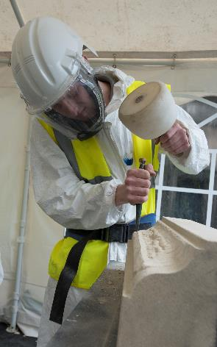
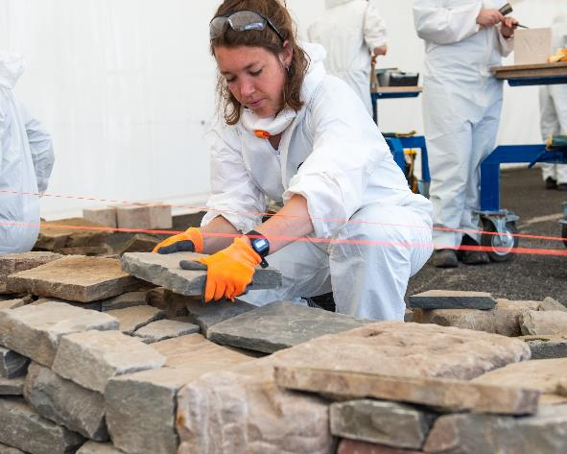
Careers
We can defend our historic sites by making sure we have enough people with the right skills to protect, repair, and manage our sites now and in the future.
Keeping traditional skills alive is essential
to enable us to care for historic sites.
Notes:
Some of the traditional skills need by HES: thatching; stonemasonry; drystone construction.
Left: 008-000-026-968-C – re thatching at Arnol Blackhouse; © Historic Environment Scotland.
Middle: 008-000-006-837-C – stonemason using a mell and chisel; © Crown Copyright HES
Right: 008-000-082-498-C – drystane construction; © Historic Environment Scotland

Slide 19
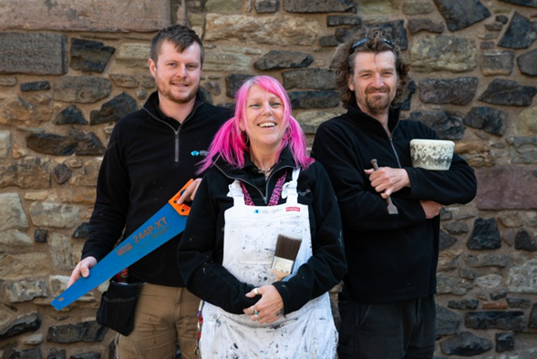
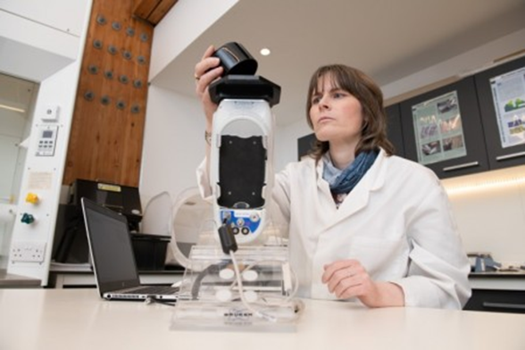
Types of careers
HES offer apprenticeships in traditional skills including:
stonemasonry
blacksmithing
gardening
We also need researchers, surveyors and scientists to develop new ideas and methods of protecting our sites for the future.
To learn more, try the Heritage careers activity.
Notes:
See also careers fact and activity sheets.
Suggested links:
Scottish Stonemasonry at The White House - YouTube
How To Be A Holyrood Ranger - YouTube
Meet The Modern Apprentices at Edinburgh Castle - YouTube
008-000-084-211-C: Painter, joiner and stonemason at Edinburgh Castle; © Historic Environment Scotland
008-000-091-676-C: Conservation Scientist; © Historic Environment Scotland

Slide 20
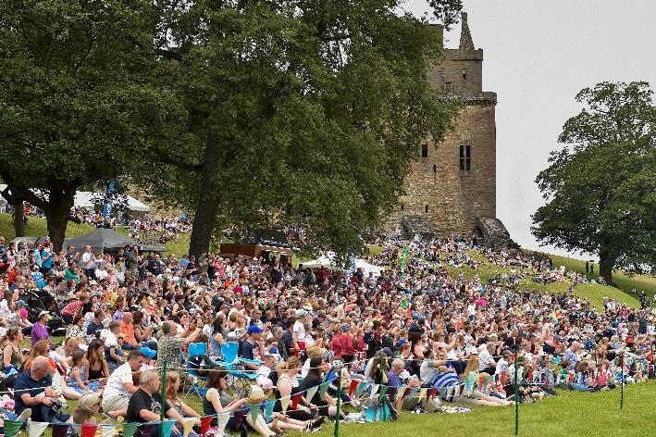
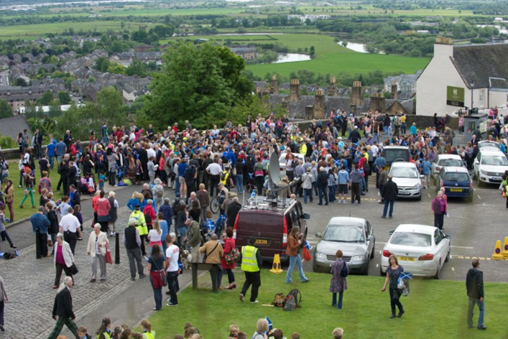
Sustainability
Managing our historic places and encouraging people to visit them in a more sustainable way means we are looking after the historic environment now and for the future.
If people think about the impact of visiting a site they can help protect it.
Notes:
See also sustainability fact and activity sheets which can also support discussion.
Suggested links:
What is sustainable tourism? – YouTube
Top: 008-000-084-358-C: large crowd at a HES event at Linlithgow Palace; © Alastair Ross.
Bottom: 008-001-078-871-C: crowd in car park at Stirling Castle; © Rob McDougall

Slide 21
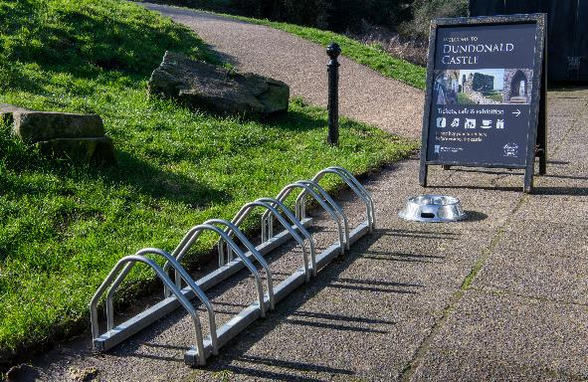
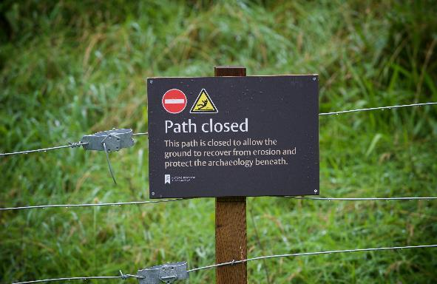
Thinking about sustainability
We need to think about:
how many visitors can the site have (its capacity)?
how do visitors travel
to the site?
what are they doing when they are visiting?
what facilities do we provide?
We also need to consider:
how could local people help look after a place?
how can we encourage visitors to behave responsibly?
What effect might too many visitors have on your local site?
Notes:
008-000-091-333-C – bike racks at Dundonald Castle; © Historic Environment Scotland
008-000-092-755-C – paths closed sign at Doune Castle; © Rob McDougall

Slide 22
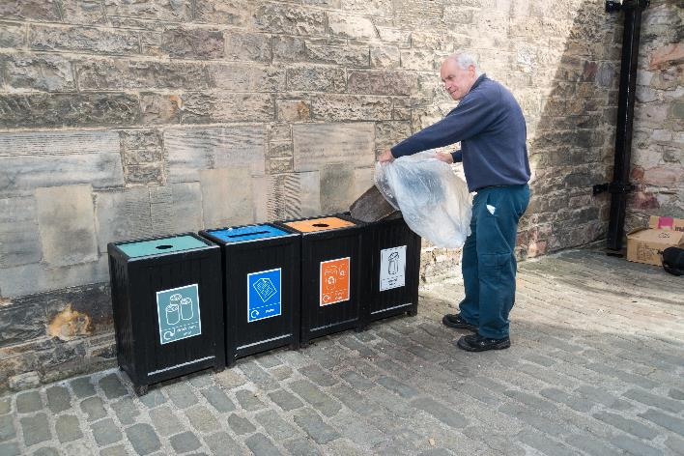
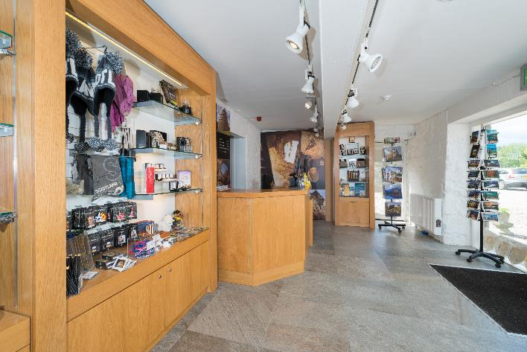
Sustainability at your local site
Now you know more about sustainability and its impacts, why not visit your local site with this knowledge.
What examples of sustainability can you find?
What ideas do you have to make your local site more sustainable?
To learn more, try the sustainability activity.
Notes:
008-000-035-898-C: recycling bins at Edinburgh Castle; © Historic Environment Scotland
008-000-020-428-C: inside the shop at Aberdour Castle; © Crown Copyright HES

Slide 23

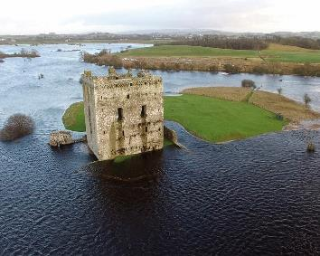

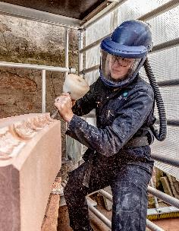

Your mission…
Choose a threat:
heritage crime
climate change
Choose a defence:
conservation
careers
sustainability

Slide 24

…defend your local site!
Research the threats/challenges facing your local place, then create something to tell other young people about it and what they could do to help.
For example, you could design
and create:
a newspaper or e-zine
‘protest posters’ for a campaign
leaflets to give out
a display or stall
a comic book
Information banner created by Knoxland Primary School, Dumbarton.
Notes:
Banner © Knoxland primary school.

Slide 25
Links and resources
About Historic Environment Scotland
Property pages
for HES sites
Statement of Significance
(an explanation of each property’s value and why we look after it)
Scran
Canmore
Learning with HES
Defending Scotland’s Heritage fact sheets on:
careers
climate change
conservation
heritage crime
sustainability

