Slide 1
What is Heritage?

Slide 2
Aim: To raise awareness and increase understanding of what is meant by ‘heritage’ and that the value we place on it can be subjective and personal
Notes:
Resources required:
images of buildings/objects (on subsequent slides – a list of what each image is can be found at the end of the Powerpoint. The images are in a rough order: International heritage, UK heritage, Scottish heritage and local heritage but should be re-arranged for use by participants)
Headings : ‘worth keeping for the future’ and ‘not worth keeping’
Teachers notes containing options for running the activity can be found at the end of the Powerpoint

Slide 3
Instructions
In your groups, look through the set of images
Discuss whether you recognise the image, know what the image is of
Discuss and decide which of two headings each image should be put under: Worth keeping for the future OR Not worth keeping for the future
Once you have put all the images under a heading, explain your decisions
Once you have decided what’s worth keeping, choose the five images that your group think are most important and explain why
Notes:
Suggested extension activity: groups or individuals could pick three images and try to find more information about them.
See Teachers notes at the end for useful sources.

Slide 4
Pyramids
Notes:
1. 000-000-662-653-R © Robert Gordon University. Licensor www.scran.ac.uk

Slide 5
Statue of Liberty
Notes:
2. 005-000-000-519-R © Jacquie Knox. Licensor www.scran.ac.uk

Slide 6
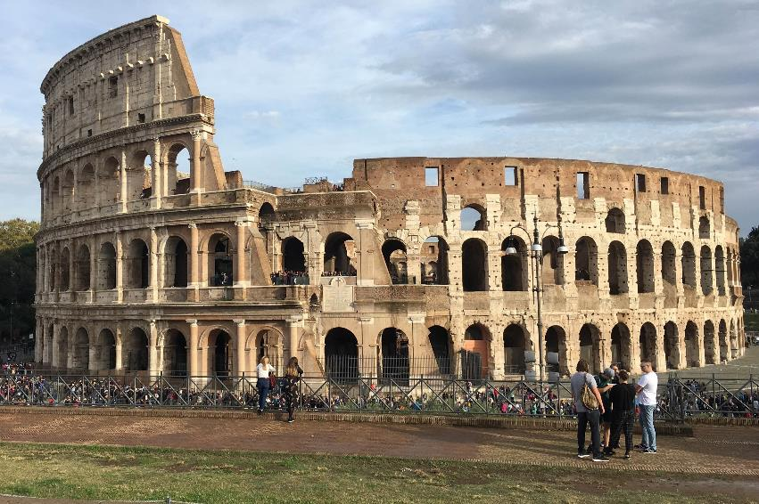
Colosseum
Notes:
3. 008-000-104-034-R © Laurie Risk.

Slide 7
The little mermaid and bronze head
Notes:
4. Left: 008-000-104-038-R © Laurie Risk
5. Right: 000-180-000-753-R © National Museums Scotland. Licensor www.scran.ac.uk

Slide 8
Easter Island heads
Notes:
6. © Easter Island Allan Kilpatrick eiak281006002

Slide 9
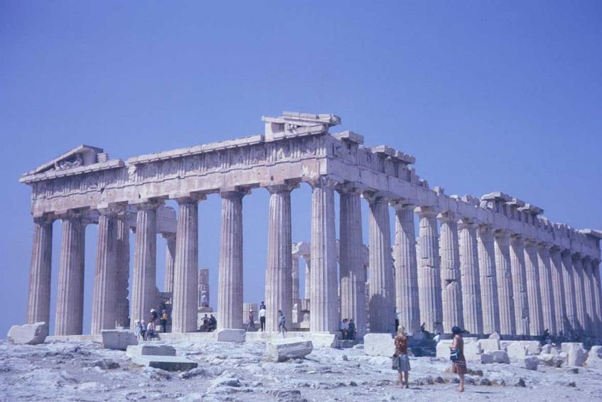
Parthenon
Notes:
7. 000-000-662-632-R © Robert Gordon University. Licensor www.scran.ac.uk

Slide 10
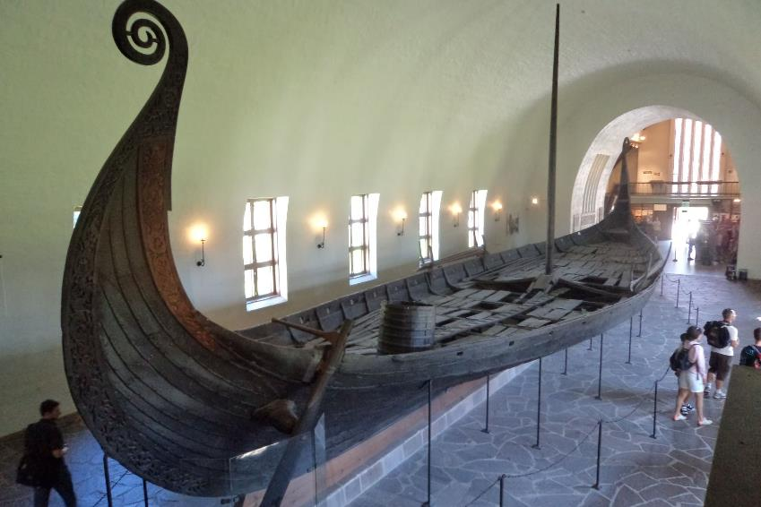
Viking ship
Notes:
8. 005-000-004-380-R © Andrew James. Licensor www.scran.ac.uk

Slide 11
Taj Mahal
Notes:
9. 005-000-003-962-R © Mira Knoche. Licensor www.scran.ac.uk

Slide 12
Stonehenge
Notes:
10. 000-000-674-216-R © Robert Gordon University. Licensor www.scran.ac.uk

Slide 13
Hadrian’s Wall and windmill
Notes:
11. Left: 000-000-554-228-R © Colin J M Martin. Licensor www.scran.ac.uk
12. Right: 000-000-673-712-R © Robert Gordon University. Licensor www.scran.ac.uk

Slide 14
Giant’s causeway and mosaic
Notes:
13. Left:© Wikimedia Commons – NEED TO CHECK LICENSING AND LINK
14. Right: © Sussex Archaeological Society

Slide 15
York minster
Notes:
15. 008-000-104-027-R © Laurie Risk.

Slide 16
Forth rail bridge
Notes:
16. 008-000-075-266-R © Historic Environment Scotland

Slide 17
Lewis chessmen
Notes:
17. 000-190-001-117-R © National Museums Scotland.

Slide 18
Edinburgh Castle
Notes:
18. 008-000-091-762-R © Historic Environment Scotland

Slide 19
Rough Castle, Roman fort
Notes:
19. 008-001-002-066-R © Crown Copyright HES.

Slide 20
Skara Brae
Notes:
20. 008-001-073-909-R © Crown Copyright HES.

Slide 21
The Pineapple
Notes:
21. 008-000-104-357-R © Laurie Risk.

Slide 22
Chambered cairn
Notes:
22. 000-000-025-241-R © Diego Meozzi. Licensor www.scran.ac.uk

Slide 23
Village green with weigh-beam
Notes:
23. 000-000-470-088-R © East Lothian Museums Service. Licensor www.scran.ac.uk

Slide 24
Phone box
Notes:
24. 000-000-619-967-R © Neil Sinclair. Licensor www.scran.ac.uk

Slide 25
WWII defences
Notes:
25. © Fiona McLaren

Slide 26
Gravestone
Notes:
26. 008-000-072-983-R © Historic Environment Scotland

Slide 27
Banana flats
Notes:
27. 008-000-041-677-R © Historic Environment Scotland.

Slide 28
Old cottage
Notes:
28. 008-001-009-762-R © Crown Copyright HES.

Slide 29
Hippodrome theatre
Notes:
29. 008-001-018-994-R © Crown Copyright HES.

Slide 30
Machrie Moor stone circle
Notes:
30. 008-001-008-493-R © Crown Copyright HES.

Slide 31
WWII German graffiti
Notes:
31. 008-001-040-559-R © Crown Copyright HES.

Slide 32
Stone steps
Notes:
32. 008-001-065-371-R © Crown Copyright HES.

Slide 33
Hippo statues
Notes:
33. 008-001-070-196-R © Crown Copyright HES.

Slide 34
Football stadium
Notes:
34. © RCAHMS

Slide 35
Miner’s lamp and skatepark
Notes:
35. Left: Lamp – 000-000-094-407-R © Almond Valley Heritage Trust. Licensor www.scran.ac.uk
36. Right: Skatepark – 000-000-199-381-R © West Lothian Archives and Records Centre. Licensor www.scran.ac.uk

Slide 36
Dovecot and milemarker
Notes:
37. Left: Doocot – 000-000-466-296-R © National Museums Scotland. Licensor www.scran.ac.uk
38. Right: Milestone – 000-000-466-653-R © National Museums Scotland. Licensor www.scran.ac.uk

Slide 37
Standing stone and Victorian advertising
Notes:
39. Left: 008-000-102-668-R © Historic Environment Scotland
40. Right: 008-000-104-476-R © Historic Environment Scotland.

Slide 38
Car park
Notes:
41. 000-000-532-324-R © The Scotsman Publications Ltd. Licensor www.scran.ac.uk

Slide 39
List of images
International
The Pyramids and Sphinx at Giza, Egypt, c2500BC
Statute of Liberty, New York, built 1886
The Colosseum, giant amphitheatre, Rome, built 70AD
The Little Mermaid bronze statue, Copenhagen, Denmark, 1913
13th century Benin Bronze sculpture, Nigeria
Moai statues, Easter Island, Pacific Ocean, made between 1250-1500AD
Parthenon temple, Athens, Greece, 5th century BC
Viking long ship, Norway
Taj Mahal mausoleum, India, built 1600s

Slide 40
List of images 2
UK
Stonehenge prehistoric stone circle, England, 5000 years old
Hadrian’s Wall, Roman era defensive structure, England, built 122AD
19th century windmill, Nottinghamshire
Giant’s Causeway, natural basalt columns, Northern Ireland
Mosaic floor showing Cupid on a Dolphin, Fishbourne Roman Palace, England, 75AD
York Minster, Medieval Cathedral, England

Slide 41
List of images 3
Scotland
Forth Rail Bridge, built 1889
Lewis Chess pieces, Medieval
Edinburgh Castle
Skara Brae Neolithic village, Orkney, 5000 years old
Roman Lillia (defensive pits), Rough Castle fort, Antonine Wall, 140AD
The Pineapple, summerhouse, Falkirk, Scotland, built 1761

Slide 42
List of images 4
Local areas
Barpa Langass Neolithic burial cairn, North Uist
Wooden Market Cross, Stenton, East Lothian
Traditional red post box and telephone box, Jura
WWII concrete anti tank blocks, East Lothian
18th century gravestone, St Andrews
20th century ‘banana’ flats, Leith, Edinburgh
18th century cruck-framed cottage, Pitlochry
Hippodrome, Boness, Art Deco era theatre, opened 1912
Prehistoric Stone Circle, Arran
WWII German Graffiti, Duff House, Aberdeenshire
‘Loupin’ On Stane (steps to help get on a horse) Duddingston, 17th century

Slide 43
List of images 5
Local areas
Hippo concrete sculptures, Glenrothes, 1970s
Starks Park Football Stadium, Kirkcaldy, Fife, originally built 1891
Miners lamp, West Lothian, c1910
Skatepark, Livingston, opened 1981
Lectern doocot, for keeping pigeons, Athelstaneford, East Lothian, 1583
Milestone, Portpatrick, Dumfries
Prehistoric standing stone, Inverness
Victorian era ghost sign (old hand-painted advertising preserved on a building, Edinburgh
20th century Car Park B, Castle Terrace, Edinburgh

Slide 44
Teachers notes
This activity is designed to be undertaken in small groups using printed materials but can be adapted to suit, e.g. using a Smartboard.
Divide participants into smaller groups
Print out a set of the images and set of both headings for each group
The images all represent different types of ‘heritage’. Some images are of famous/international heritage sites, some are nationally well known, others are examples of local heritage and are grouped in that order in the Powerpoint
Groups can discuss what the images are of and identify any they recognise
Groups should discuss each image and decide which heading it should go under - ‘worth keeping for the future’ and ‘not worth keeping’
At the end groups can compare how they sorted their piles and explain their decisions. This should lead into a discussion of why a place or object is worth keeping and the concept of ‘heritage’ can be introduced

Slide 45
Useful sources
Canmore canmore.org.uk
World Heritage website
whc.unesco.org
HES YouTube What is a Listed Building? Video: 2m 10s

